Slide 1
Subject: MATHEMATICS
Term: FIRST TERM
Session : 2023/2024
Class : GRADE NINE
Educator: Mr. AUSTIN

Slide 2
SCHEME OF WORK
WEEK 1:
NUMBERS AND NUMERATION
BINARY SYSTEM
WEEK 2
WEEK 3:
BINARY SYSTEM
TRIGONOMETRY 1
WEEK 4
WEEK 5:
ALGEBRAIC EQUATION 1
WORD PROBLEMS
WEEK 6
WEEK 7:
MID TERM BREAK
FACTORIZATION 1
WEEK 8
WEEK 9:
FACTORIZATION 2
GEOMETRICAL CONSTRUCTION
WEEK 10
WEEK 11:
REVISION
EXAMINATION
WEEK 12

Slide 3
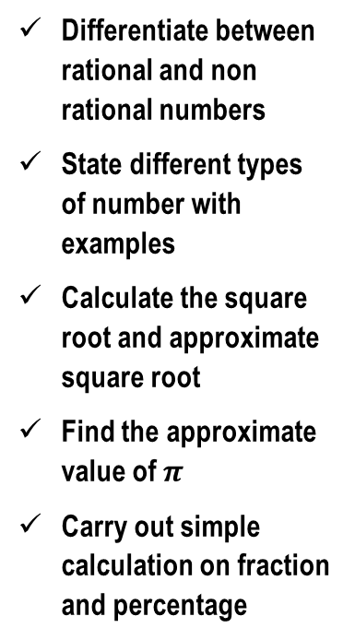
TOPIC: numbers and numeration
Differentiate between rational and non rational numbers
State different types of number with examples
Calculate the square root and approximate square root
Find the approximate value of $π$
Carry out simple calculation on fraction and percentage
NUMBERS AND NUMERATION
HOME PAGE
Rational numbers: they are any numbers that is an exact fraction
Irrational number : any number that is not an exact fraction
Non rational numbers : this is another word for irrational number

Slide 4
INTRODUCTION.
Numeration is a concept that deals with number system. I.e different ways of expressing numbers and manipulation of numbers .
But in this lesson , we shall be focusing on arithmetics.
Our area of concentration are: types of numbers finding the square root of number approximation fraction percentage
TOPIC: NUMBERS AND NUMERATION

Slide 5
TYPES OF NUMBERS .
REAL NUMBERS :real numbers are numbers with no imaginary part. They can rational or irrational numbers.
INTEGERS: integers are whole numbers . I.e numbers which are not fractions composite numbers: these are numbers having more than 2 factors .
Twin prime numbers: these are two prime numbers whose difference is 2. e.g 3 and 5 prime numbers: these are numbers that have only two factors. e. g 2, 3, 5, 7, 11,….. even numbers: these are numbers that are divisible by 2. e.g 2,4,6,8,10,…….. odd numbers : these are numbers that are not divisible by 2. e.g 1,3,5 ,7,9…. sexy prime numbers: these are prime numbers that differ from each others by 6 e.g 5 and 11 figurative numbers octagonal numbers triangle numbers e t c
.
TOPIC: NUMBERS AND NUMERATION

Slide 6
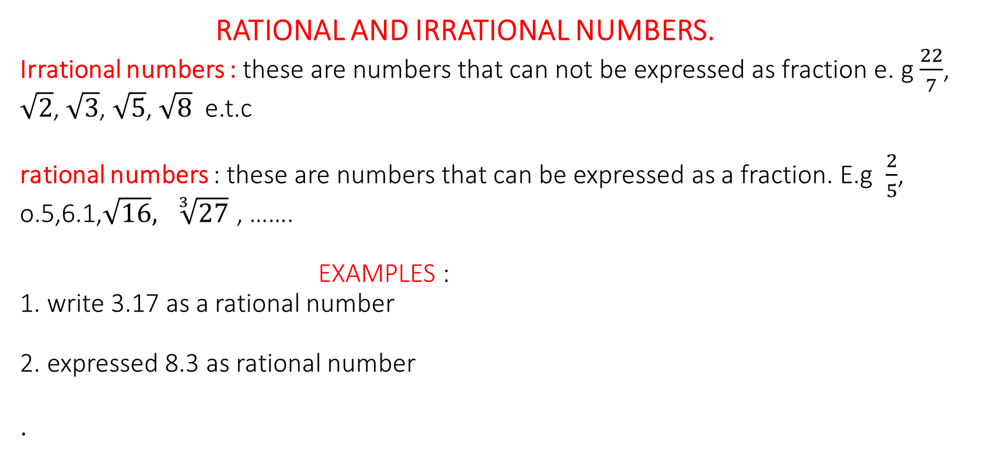
RATIONAL AND IRRATIONAL NUMBERS.
Irrational numbers : these are numbers that can not be expressed as fraction e. g $\frac{22}{7}$, $\sqrt{2}$, $\sqrt{3}$, $\sqrt{5}$, $\sqrt{8}$ e.t.c rational numbers : these are numbers that can be expressed as a fraction. E.g $\frac{2}{5}$, o.5,6.1,$\sqrt{16}, \sqrt[3]{27}$ , …….
EXAMPLES :
1. write 3.17 as a rational number
2. expressed 8.3 as rational number
.
TOPIC: NUMBERS AND NUMERATION

Slide 7
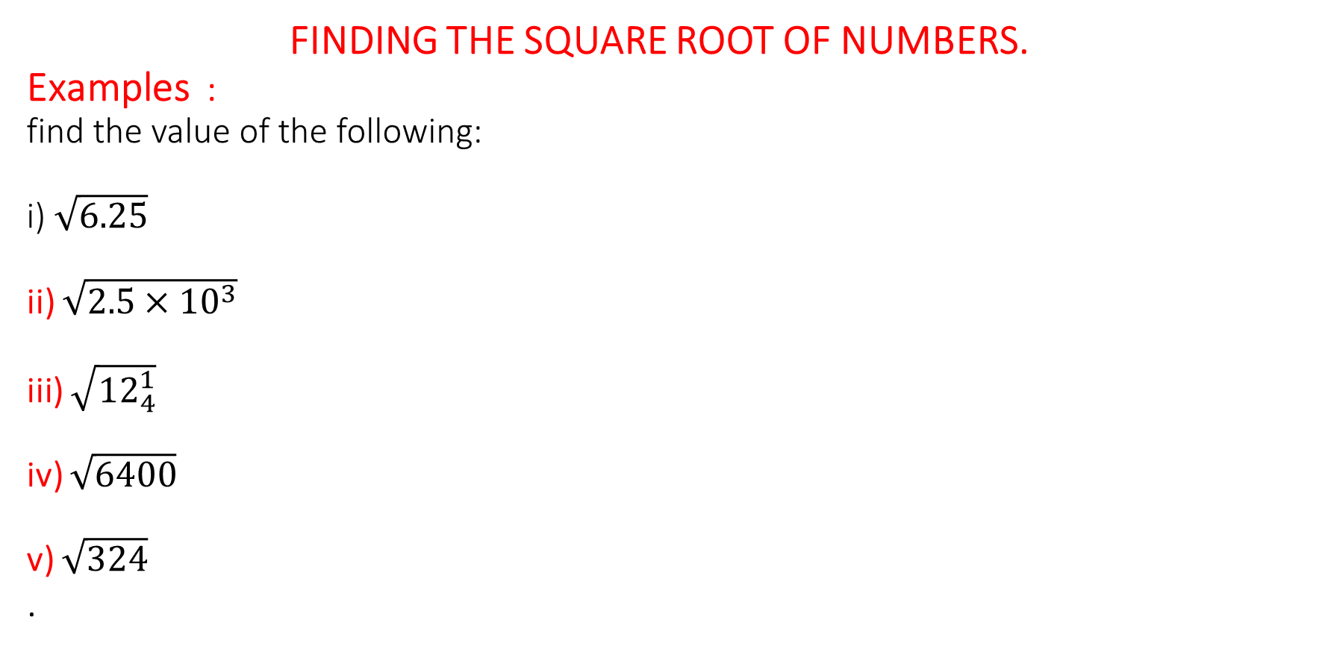
FINDING THE SQUARE ROOT OF NUMBERS.
Examples : find the value of the following: i) $\sqrt{6.25}$ ii) $\sqrt{2.5×{10}^{3}}$ iii) $\sqrt{{12}_{4}^{1}}$ iv) $\sqrt{6400}$ v) $\sqrt{324}$
.
TOPIC: NUMBERS AND NUMERATION

Slide 8
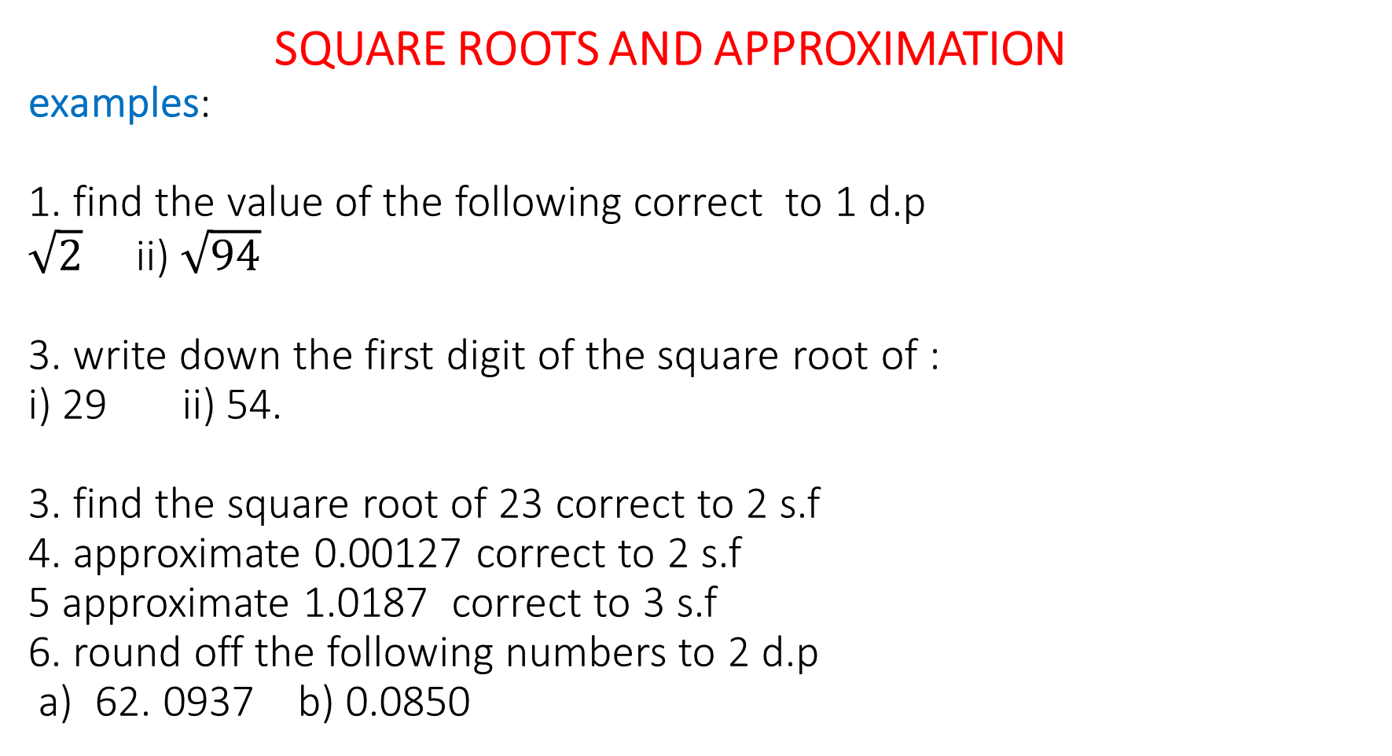
SQUARE ROOTS AND APPROXIMATION examples:
1. find the value of the following correct to 1 d.p
$\sqrt{2}$ ii) $\sqrt{94}$
3. write down the first digit of the square root of : i) 29 ii) 54.
3. find the square root of 23 correct to 2 s.f
4. approximate 0.00127 correct to 2 s.f
5 approximate 1.0187 correct to 3 s.f
6. round off the following numbers to 2 d.p a) 62. 0937 b) 0.0850
TOPIC: NUMBERS AND NUMERATION

Slide 9
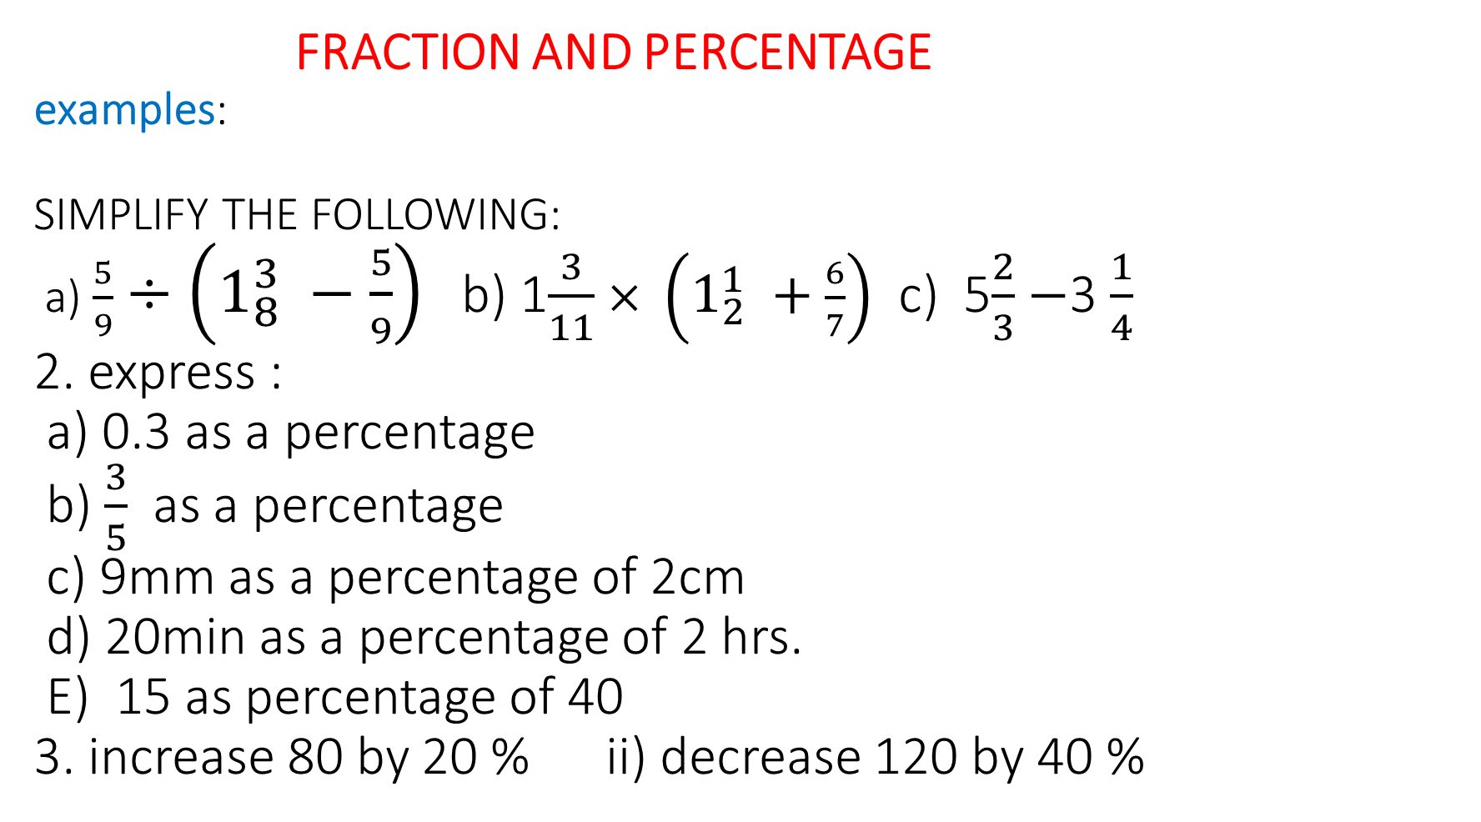
FRACTION AND PERCENTAGE examples:
SIMPLIFY THE FOLLOWING: a) $\frac{5}{9}$ $÷\left(1_{8}^{3} −\frac{5}{9}\right)$ b) 1$\frac{3}{11}$ $× \left(1_{2}^{1} +\frac{6}{7}\right)$ c) 5$\frac{2}{3}$ $−$3 $\frac{1}{4}$
2. express : a) 0.3 as a percentage b) $\frac{3}{5}$ as a percentage c) 9mm as a percentage of 2cm d) 20min as a percentage of 2 hrs.
E) 15 as percentage of 40
3. increase 80 by 20 % ii) decrease 120 by 40 %
TOPIC: NUMBERS AND NUMERATION

Slide 10
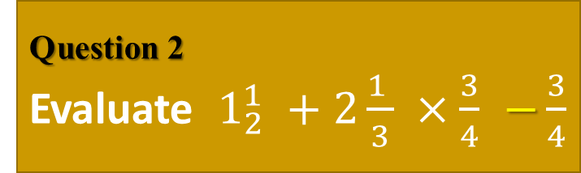
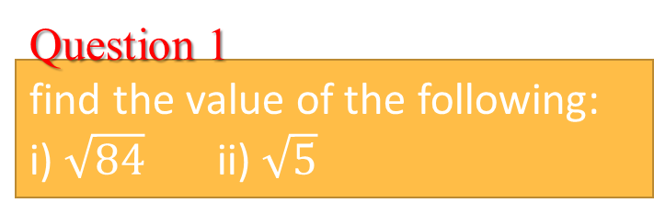
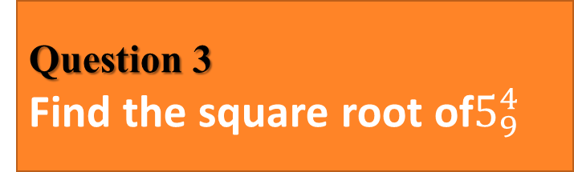
TOPIC: numbers and numeration>> Evaluation
Question 1
find the value of the following:
i) $\sqrt{84}$ ii) $\sqrt{5}$
Question 1
Round off 0.00345 to 2 s. f
Question 2
Evaluate $1_{2}^{1} +2\frac{1 }{3} ×\frac{3}{4}$ $−\frac{3}{4}$
Question 2
10sec as a percentage of 5 min
Question 3
Find the square root of$5_{9}^{4}$
Question 3
Find the sum of – 3.25 and 7.75
Question 4
Round off 18 .02 to 1 s.f
Question 4
Find the sum of the product of 4 and 5 and the negative difference between 3 and 10

Slide 11
TOPIC: BINARY SYSTEM
Performs operations in binary system.
Converts numbers in base two to other base and vice versa
Convert numbers in base ten to other bases and vice versa
Solve some quantitative aptitude problems on binary number systems.
BINARY SYSTEM
HOME PAGE

Slide 12
Number base is a system of counting in bundles.
Most people count in tens and others people traditionally counts in fives and others in 20s.
In Nigeria, we conventionally count in ten. Hence base ten is commonly referred to as common base
TOPIC: BINARY SYSTEM

Slide 13
EXPANSION AND CONVERSION OF OTHER BASES
TO BASE TEN
WORKED EXAMPLES:
Expand the following in the powers of their bases:
4956 _{ten} b. 320745 _{eight} c. 11101 _{two}
TOPIC: BINARY SYSTEM

Slide 14
Solution : a. 4956 ten = 4 𝚡 10 ³ + 9 𝚡 10 ² + 5 𝚡 10 ¹ +
6 𝚡 10 ⁰ b. 320 745 _{eight} = 3 𝚡 10 ⁵ + 2 𝚡 10 ⁴ + 0 𝚡 10 ³ +
7 𝚡 10 ² + 4 𝚡 8 ¹ + 5 𝚡 8 ⁰ c. 11101 _{two} = 1 𝚡 10 ⁴ + 1 𝚡 10 ³ + 1 𝚡 10 ² +
0 𝚡 10 ¹ + 1 𝚡 10 ⁰
TOPIC: BINARY SYSTEM

Slide 15
CONVERSION OF BASE TEN NUMBERS TO OTHER
BASES
WORKED EXAMPLES 2:
Convert 37 _{ten} to base eight
Convert 75 _{ten} to base four
Change 95 _{ten} to base two
Change 569 _{ten} to base six
TOPIC: BINARY SYSTEM

Slide 16
SOLUTION a. 37 ÷ 8 = 4 remainder 5
4 ÷ 8 = 0 remainder 4
⇒ 37 _{ten} = 45 _{eight} b. 75 ÷ 4 = 18 remainder 3
18 ÷ 4 = 4 remainder 2
4 ÷ 4 = 1 remainder 0
1 ÷ 4 = 0 remainder 1
⇒ 75 _{ten} = 1023 _{four}
TOPIC: BINARY SYSTEM

Slide 17
c. 95 ÷ 2 = 47 remainder 1
47 ÷ 2 = 23 remainder 1
23 ÷ 2 = 11 remainder 1
11 ÷ 2 = 5 remainder 1
5 ÷ 2 = 2 remainder 1
2 ÷ 2 = 1 remainder 0
1 ÷ 2 = 0 remainder 1
⇒ 95 _{ten} = 1011111 _{two}
TOPIC: BINARY SYSTEM

Slide 18
d. 569 ÷ 6 = 94 remainder 5
94 ÷ 6 = 15 remainder 4
15 ÷ 6 = 2 remainder 3
2 ÷ 6 = 0 remainder 2
⇒ 569 _{ten} = 2345 _{six}
TOPIC: BINARY SYSTEM

Slide 19
TOPIC: BINARY SYSTEM
CONVERSION OF OTHER BASE TO BASE TEN
WORKED EXAMPLES :
Convert 100110 _{two} to base ten
Convert 432 _{five} to base ten

Slide 20
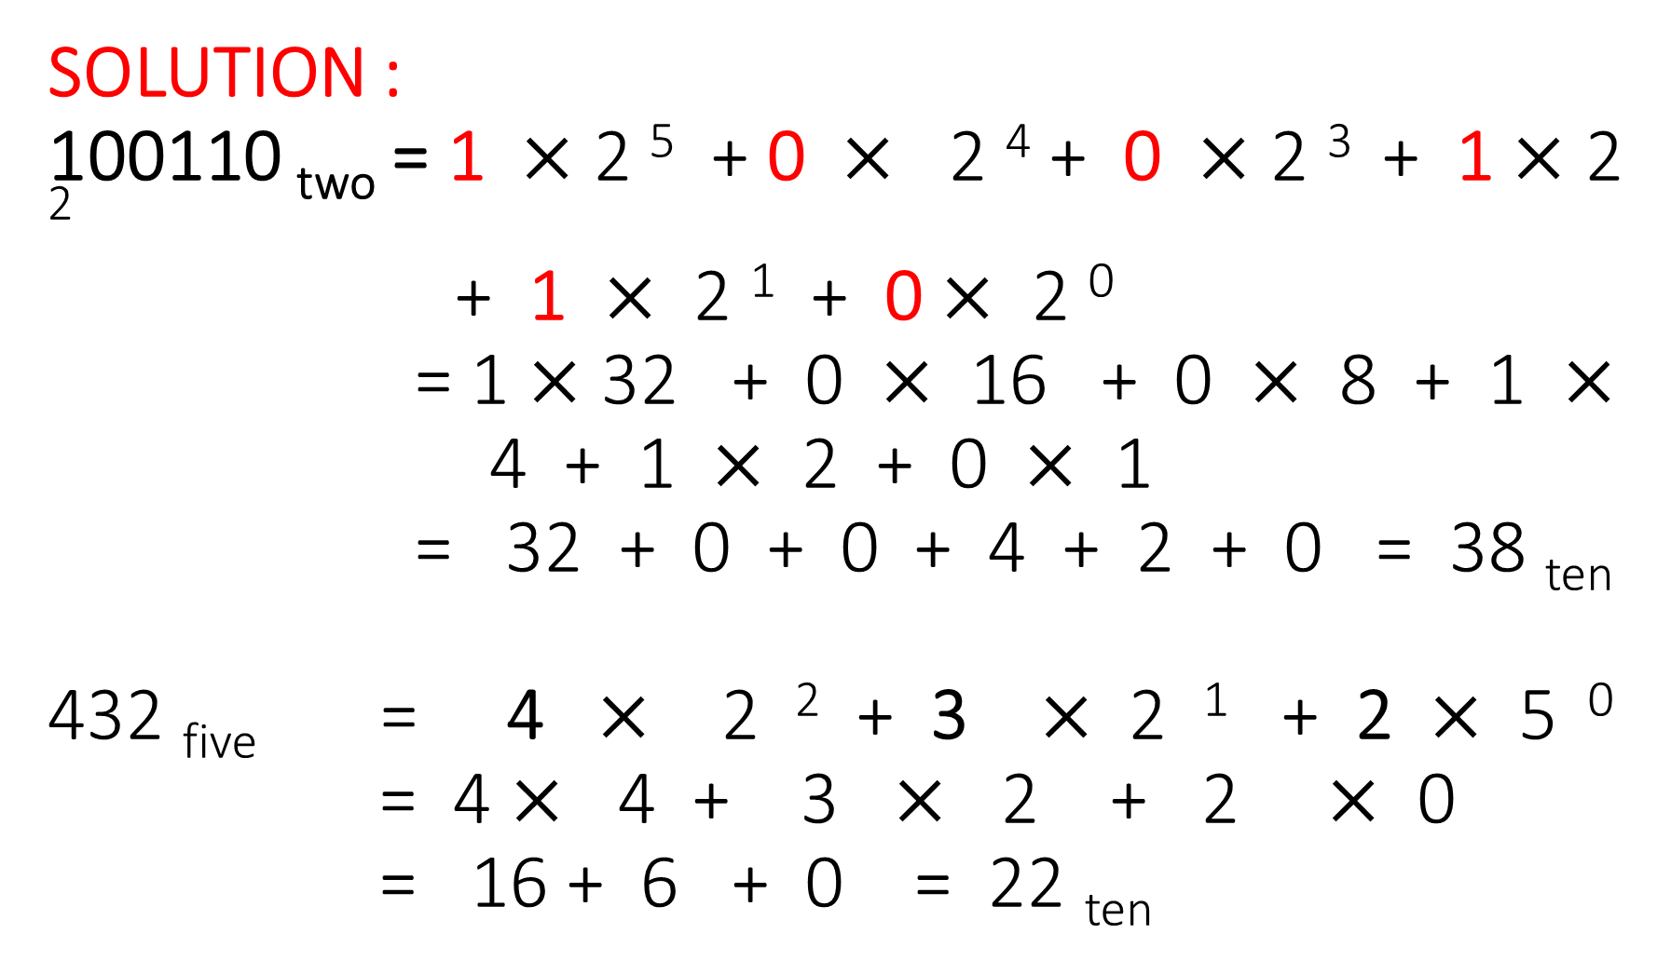
SOLUTION :
100110 _{two} = 1 $×$ 2 ⁵ + 0 $×$ 2 ⁴ + 0 $×$ 2 ³ + 1 $×$ 2 ²
+ 1 $×$ 2 ¹ + 0 $×$ 2 ⁰
= 1 $×$ 32 + 0 $×$ 16 + 0 $×$ 8 + 1 $×$4 + 1 $×$ 2 + 0 $×$ 1
= 32 + 0 + 0 + 4 + 2 + 0 = 38 _{ten}
432 _{five} = 4 $×$ 2 ² + 3 $×$ 2 ¹ + 2 $×$ 5 ⁰
= 4 $×$ 4 + 3 $×$ 2 + 2 $×$ 0
= 16 + 6 + 0 = 22 _{ten}
TOPIC: BINARY SYSTEM

Slide 21
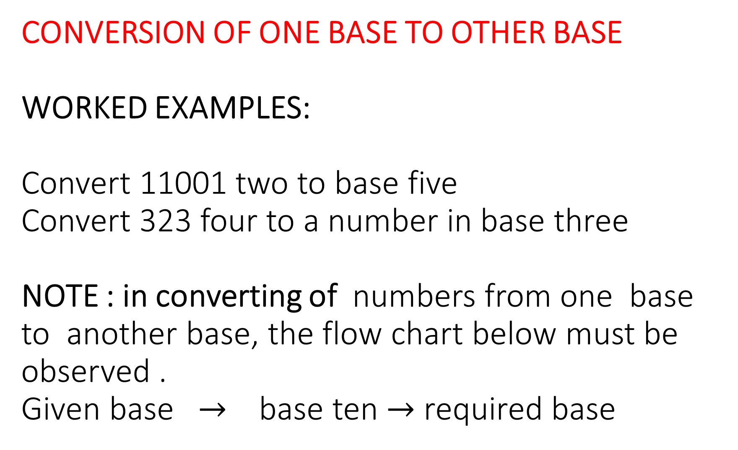
CONVERSION OF ONE BASE TO OTHER BASE
WORKED EXAMPLES:
Convert 11001 two to base five
Convert 323 four to a number in base three
NOTE : in converting of numbers from one base to another base, the flow chart below must be observed .
Given base $→$ base ten $→$ required base
TOPIC: binary system

Slide 22
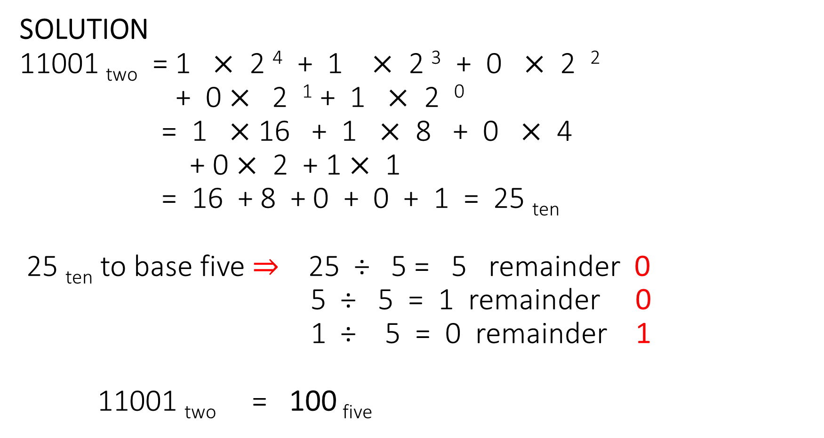
SOLUTION
11001 _{two} = 1 $×$ 2 ⁴ + 1 $×$ 2 ³ + 0 $×$ 2 ²
+ 0 $×$ 2 ¹ + 1 $×$ 2 ⁰
= 1 $×$ 16 + 1 $×$ 8 + 0 $×$ 4
+ 0 $×$ 2 + 1 $×$ 1
= 16 + 8 + 0 + 0 + 1 = 25 _{ten}
25 _{ten} to base five ⇒ 25 ÷ 5 = 5 remainder 0
5 ÷ 5 = 1 remainder 0
1 ÷ 5 = 0 remainder 1
11001 _{two} = 100 _{five}
TOPIC: binary system

Slide 23
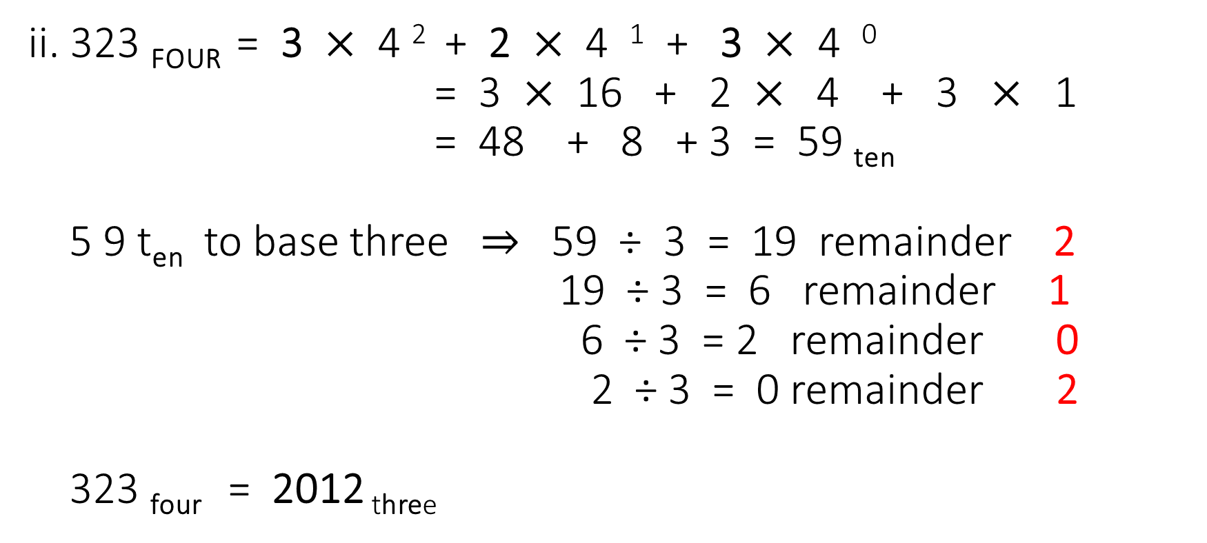
ii. 323 _{FOUR} = 3 $×$ 4 ² + 2 $×$ 4 ¹ + 3 $×$ 4 ⁰
= 3 $×$ 16 + 2 $×$ 4 + 3 $×$ 1
= 48 + 8 + 3 = 59 _{ten}
5 9 t_{en} to base three $⇒$ 59 ÷ 3 = 19 remainder 2
19 ÷ 3 = 6 remainder 1
6 ÷ 3 = 2 remainder 0
2 ÷ 3 = 0 remainder 2
323 _{four} = 2012 _{three}
TOPIC: binary system

Slide 24
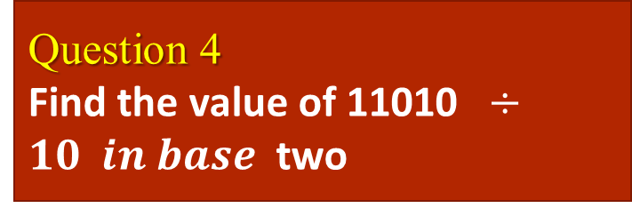
TOPIC: BIANRY SYSTEM>> Evaluation
Question 1
Exapand 56 934 in power of ten
Question 1
What is the product of 11010 and 101?
Question 2
Convert the following to base ten :
10101 _{two}
2030 _{four}
Question 2
Find the product of 10111 and 111
Question 3
convert 43 _{five} to : (a) binary (b) denary
Question 3
What is the value of ( 101 ) ³
Question 4
Find the sum of 11010 and 111
Question 4
Find the value of 11010 $÷10 in base$two

Slide 25

Any Questions?

Slide 26
TOPIC: BINARY SYSTEM
BINARY SYSTEM
contd
Performs operations in binary system.
Convert numbers in one base to other bases
Solve some quantitative aptitude problems on binary number systems (basic arithmetics on binary numbers).
Express numbers using the binary system
Add, subtract , multiply and divide binary numbers.
HOME PAGE

Slide 27
arithmetics in binary system
NOTE : Binary system is a system of counting in base two . Base two numbers belongs to the binary system.
Binary numbers are numbers with two digits only . 0 and 1 binary sytem is very important to computer technology.
TOPIC: BINARY SYSTEM

Slide 28
TOPIC: BINARY SYSTEM
TABLE OF FIRST TEN BINARY NUMBERS
^{Binary Numbers} | ^{Base ten ( Denary ) Numbers}
¹ | ¹
¹⁰ | ²
¹¹ | ³
¹⁰⁰ | ⁴
¹⁰¹ | ⁵
¹¹⁰ | ⁶
¹¹¹ | ⁷
¹⁰⁰⁰ | ⁸
¹⁰⁰¹ | ⁹
¹⁰¹⁰ | ¹⁰

Slide 29
KEY POINTS: to find the square root and the squares of binary numbers, first convert the number to base ten, find the value and then convert it back to the given base or required base.
NOTE :
1 + 1= 10 1 𝚡 1= 1
1 + 0 = 1 1 𝚡 0 = 0
0 + 0 = 0 0 𝚡 1 = 0
0 + 1 = 1 0 𝚡 0=0
TOPIC: BINARY SYSTEM

Slide 30
SOLUTION :
105 _{ten} to base two ⇒ 105 ÷ 2 = 52 remainder 1
52 ÷ 2 = 26 remainder 0
26 ÷ 2 = 13 remainder 0
13 ÷ 2 = 6 remainder 1
6 ÷ 2 = 3 remainder 0
3 ÷ 2 = 1 remainder 1
1 ÷ 2 = 0 remainder 1
105 _{ten} = 1101001 _{two}
TOPIC: BINARY SYSTEM

Slide 31
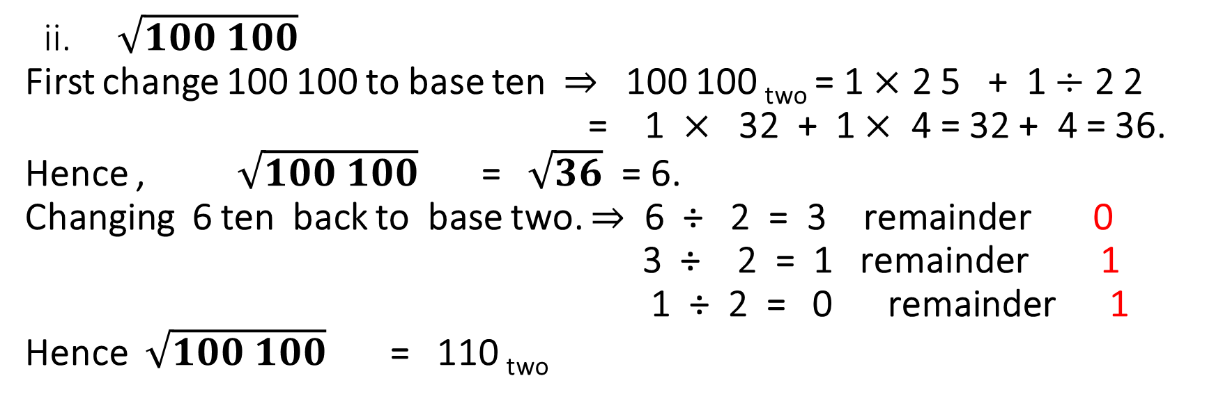
ii. $\sqrt{100 100}$
First change 100 100 to base ten $⇒$ 100 100 _{two} = 1 $×$ 2 5 + 1 $÷$ 2 2
= 1 $×$ 32 + 1 $×$ 4 = 32 + 4 = 36.
Hence , $\sqrt{100 100}$ = $\sqrt{36}$ = 6.
Changing 6 ten back to base two. $⇒$ 6 ÷ 2 = 3 remainder 0
3 ÷ 2 = 1 remainder 1
1 ÷ 2 = 0 remainder 1
Hence $\sqrt{100 100}$ = 110 _{two}
TOPIC: BINARY SYSTEM
YR 9: WK 1

Slide 32
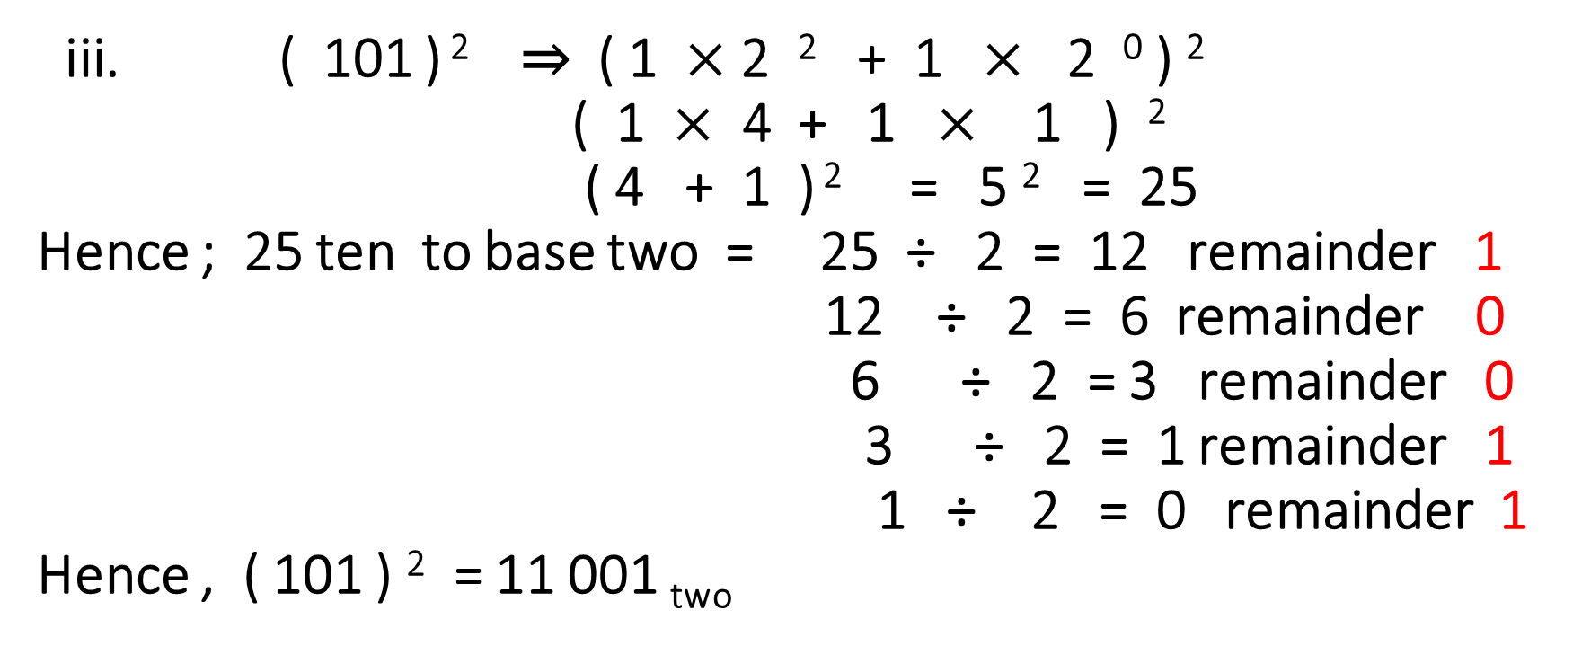
iii. ( 101 ) ² ⇒ ( 1 $×$ 2 ² + 1 $×$ 2 ⁰ ) ²
( 1 $×$ 4 + 1 $×$ 1 ) ²
( 4 + 1 ) ² = 5 ² = 25
Hence ; 25 ten to base two = 25 ÷ 2 = 12 remainder 1
12 ÷ 2 = 6 remainder 0
6 ÷ 2 = 3 remainder 0
3 ÷ 2 = 1 remainder 1
1 ÷ 2 = 0 remainder 1
Hence , ( 101 ) ² = 11 001 _{two}
TOPIC: BINARY SYSTEM

Slide 33
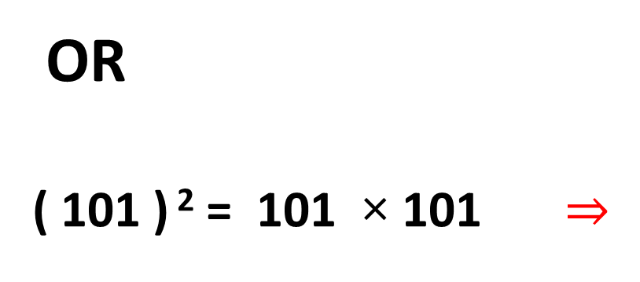
TOPIC: BINARY SYSTEM
OR
( 101 ) ² = 101 × 101 $⇒$
1 0 1
1 0 1
1 0 1
0 0 0
1 0 1
1 1 0 0 1

Slide 34
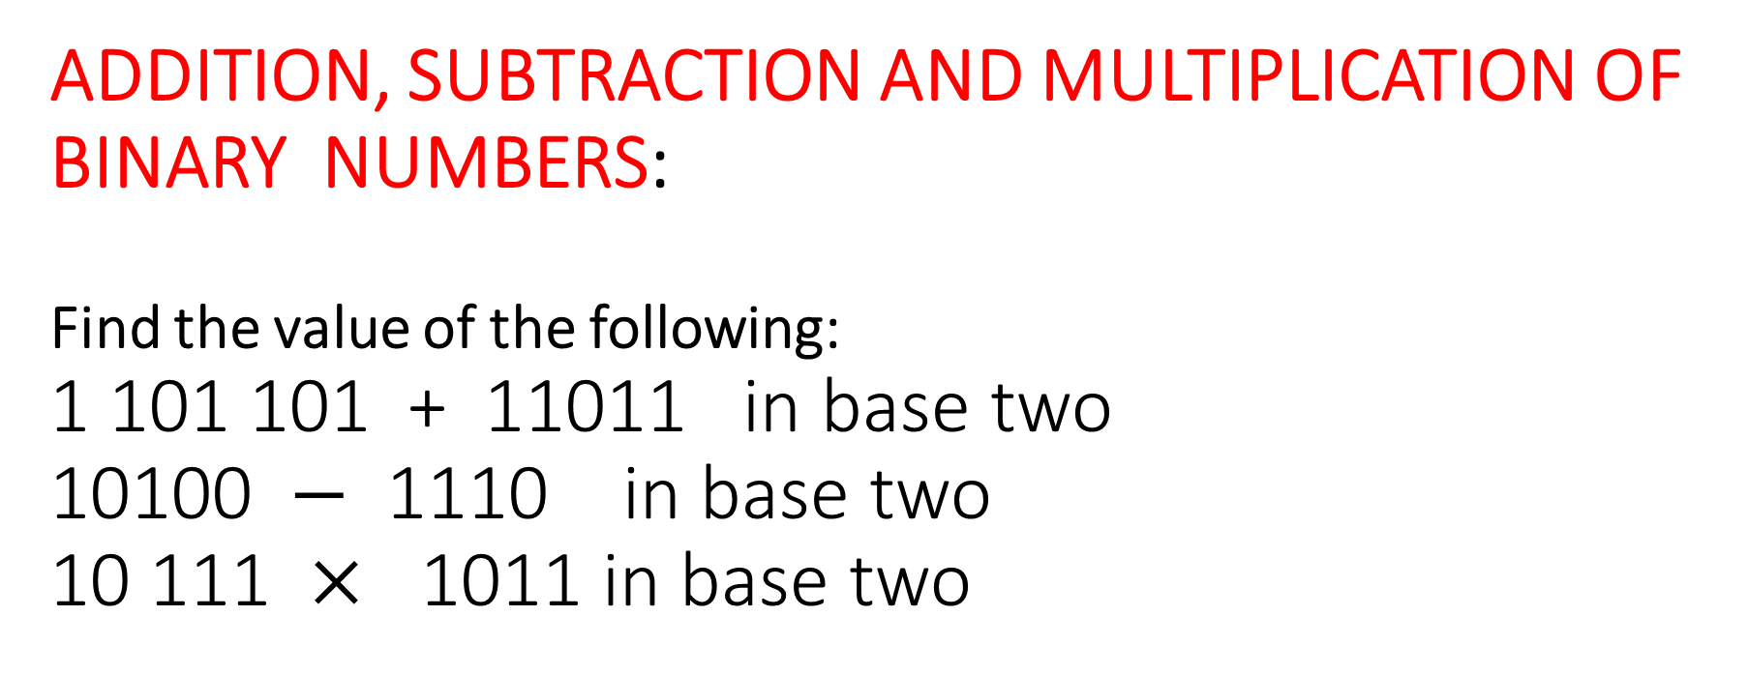
ADDITION, SUBTRACTION AND MULTIPLICATION OF BINARY NUMBERS:
Find the value of the following:
1 101 101 + 11011 in base two
10100 $−$ 1110 in base two
10 111 $×$ 1011 in base two
TOPIC: BINARY SYSTEM

Slide 35
simple equations in binary system .
WORKED EXAMPLES:
1100 two + p two = 1110. Find p
Find the base the following operation was performed
TOPIC: BINARY SYSTEM

Slide 36
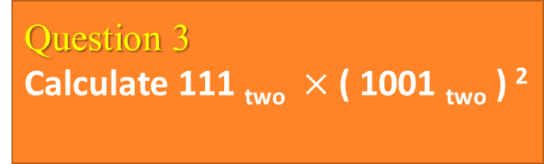
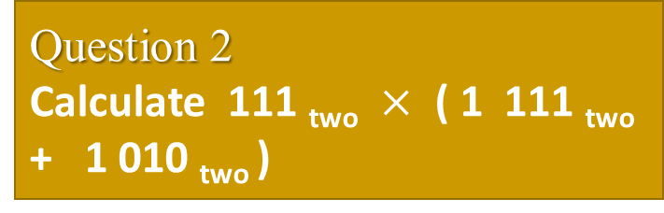
TOPIC: BINARY SYSTEM> Evaluation
Question 1
Convert 111 110 _{two} to a number in base eight
Question 1
What is the square root of 1010 001 _{two}
Question 2
Find the square of 111 _{two}
Question 2
Calculate 111 _{two} $×$ ( 1 111 _{two} + 1 010 _{two} )
Question 3
Evaluate ( 1 0 11 _{two} ) ²
Question 3
Calculate 111 _{two} $×$ ( 1001 _{two} ) ²
Question 4
Find the square root of 1000 000 _{two}
Question 4
What is the value of ( 11 _{two} ) ⁴

Slide 37
Any Questions?

Slide 38
TOPIC: TRIGONOMETRY
Defined the word trigonometry
State and identify parts of right angled triangle
State Pythagoras rules
find the missing sides of a right angled triangles using pythagoras rules
Use measurement to prove pythagoras rule.
TRIGONOMETRY
HOME PAGE

Slide 39
Introduction to trigonometry trigonometry simply means calculations involving triangles.
It can be defined as the study of the relationship in Mathematics involving length height and angles of different triangles.
In this trigonometry 1, we shall be dealing with right angled triangle and Pythagorean theorem.
.
TOPIC: trigonometry 1

Slide 40
RIGHT ANGLED TRIANGLE.
A right angled triangle is a type of triangle that has one of its angle 90⁰ i.e right angle
TOPIC: trigonometry 1

Slide 41
parts of right angled triangle hypotenuse the perpendicular the base . E.g
.
TOPIC: trigonometry 1
hypotenuse
perpendicular
base

Slide 42
pythagoras theorem: the Pythagoras theorem states “that the square on the hypotenuse of a right angled triangle is equal in area to the sum of the squares on the other two sides.” i.e , in a right angled triangle , the square of the hypotenuse side is equal to the sum of the squares of the other two sides .
The pythagoras theorem explains the relationship between the 3 sides of a right angled triangle.
E.g in a right angled triangle ACB.
TOPIC: trigonometry 1

Slide 43
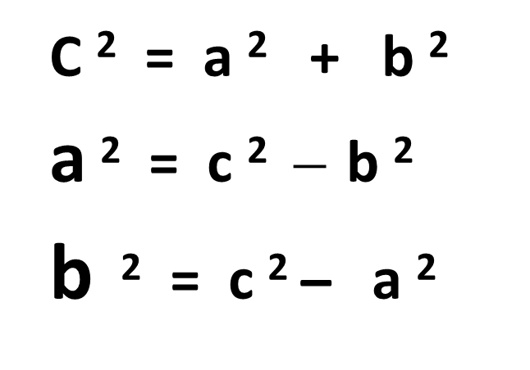
C ² = a ² + b ²
a ² = c ² $̶$ b ²
b ² = c ² ̶ a ²
TOPIC: trigonometry 1
Pythagoras formulas / equations
B
c
a
C
A
b

Slide 44
APPLICATION OF PYTHAGOREAN THEOREM TO MATHEMATICS
In Mathematics , Pythagoras rules are used to :
1. the length of the sides of right angled triangle
2. the length of the diagonals of a square or rectangles.
WORKED EXMAPLES
A rectangular hockey field is 50m long and 35m wide . Calculate the length of its diagonal
2. the sides of a triangle are 7cm, 25cm, and 26cm. Show whether this triangle is right angled or not.
3. the equal sides of an isosceles triangle are 13 cm long and the base is 24 cm. find the vertical height of the triangle.
TOPIC: trigonometry 1

Slide 45
More examples on pythagoras rule: in the diagrams below find the values of the missing sides: i.
TOPIC: trigonometry 1
12
13
4
10
5
8
5
3
4
5
80
7
48
20
24
16

Slide 46
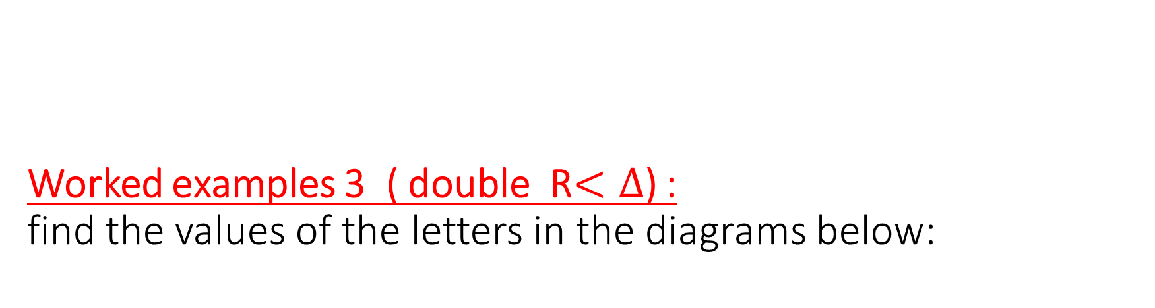
Worked examples 3 ( double R$<∆$) : find the values of the letters in the diagrams below:
TOPIC: trigonometry 1
1
2
3
17
17
5
5
15
15
h
b
13
6
x
x
8
5
a

Slide 47
TOPIC: trigonometry 1
4
13
11
8
u
7
11m
5
6
7m
y
15cm
x
x
y
w
y
12
5m
9cm
5cm
5
7

Slide 48
MORE APPLICATION OF PYTHAGORAS RULE.
1.Given that the diagonal and the length of a rectangle is 10m and 8 respectively. Find the width of the rectangle.
2. the radius and height of a cone are 48cm and 14cm respectively . Find the slant height of the cone.
3. a circle of radius 15cm has a chord of 24cm long. Calculate the distance of the chord from the centre of the circle.
4. A boy cycles 8km due east and then 15km due south . Find his distance from the starting point?
5. The diagonals of a rhombus are 6cm and 8cm respectively . Find the perimeter of the rhombus.
6. a ladder 26m long leans against a vertical wall if the distance of the foot of the ladder from the wall is 24m. How far up the wall does the ladder reach?
TOPIC: trigonometry 1

Slide 49
PYTHAGOREAN TRIPLE
Pythagorean triples are integer triples which satisfy Pythagorean equation.
Examples of Pythagorean triples are :
3,4,5 6,8,10 9,12,15
5,12,13 5, 12, 18 15, 20, 25
8,15,17 20,21,29 12, 35, 32
11, 60, 61 9,40,41 16,63,65
33,56,61 30 ,17,85 7,24,25
.
TOPIC: trigonometry 1

Slide 50
CLASS ACTIVITIES. ( Proving of pythagoras rule) method 1: by square andmeacsurment method 2: by calculation
MATERIALS :
1. plane paper or graph sheet
2. ruler
3. protractor
4. raser, biro or pencil
.
TOPIC: trigonometry 1

Slide 51
TOPIC: trigonometry Evaluation
Question 1
A chord of a circle of 24cm long is 5cm from the centre of the circle. Find its radius.
Question 1
Which of the following are Pythagorean triple? 1) 12, 35, 37 . 2) 4, 8, 9. 3) 4, 5, 6.
Question 2
Find the vertical height of a cone whose diameter is 10cm and slant height is 13cm.
Question 2
A man walked 5km northward and 8km westward. Find his distance from the starting point
Question 3
Find x and y in this fig.
6cm
y
Question 3
A rectangular piece is 120m by 60m. Find its diagonal.
3cm
x
8cm
Question 4
The diagonals of a rhombus are 6cm and 8cm respectively. Find the perimeter of the rhombus.
Question 4
Complete the Pythagorean triples below: 1) 8, __, 17 . 2) __, 8 ,10. 3) 7, 24, __ .

Slide 52
Any Questions?

Slide 53
TOPIC: algebraic equation
Solve problems on simple equations using balance methods
Solve simple equations by collecting like terms
Solve simple equations involving brackets
solving equations with unknown in the denominator
Clear fractions in algebraic equations
ALGEBRAIC EQUATION
HOME PAGE

Slide 54
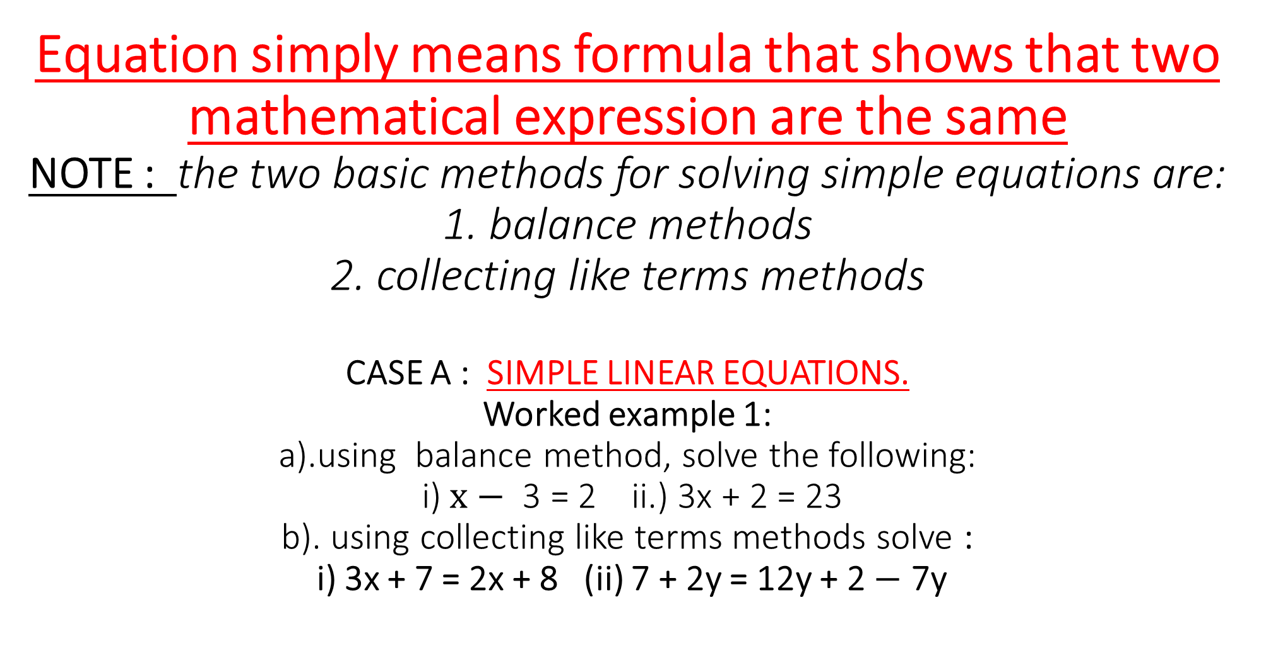
Equation simply means formula that shows that two mathematical expression are the same
NOTE : the two basic methods for solving simple equations are:
1. balance methods
2. collecting like terms methods
CASE A : SIMPLE LINEAR EQUATIONS.
Worked example 1: a).using balance method, solve the following: i) $x−$ 3 = 2 ii.) 3x + 2 = 23 b). using collecting like terms methods solve : i) 3x + 7 = 2x + 8 (ii) 7 + 2y = 12y + 2 $−$ 7y
TOPIC: algebraic equation

Slide 55
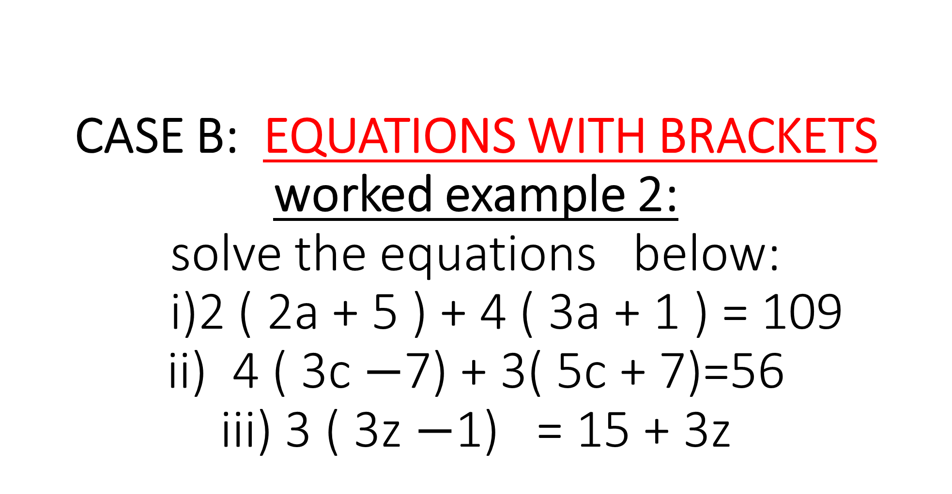
CASE B: EQUATIONS WITH BRACKETS worked example 2: solve the equations below: i)2 ( 2a + 5 ) + 4 ( 3a + 1 ) = 109 ii) 4 ( 3c $−$7) + 3( 5c + 7)=56 iii) 3 ( 3z $−$1) = 15 + 3z
TOPIC: algebraic equation

Slide 56
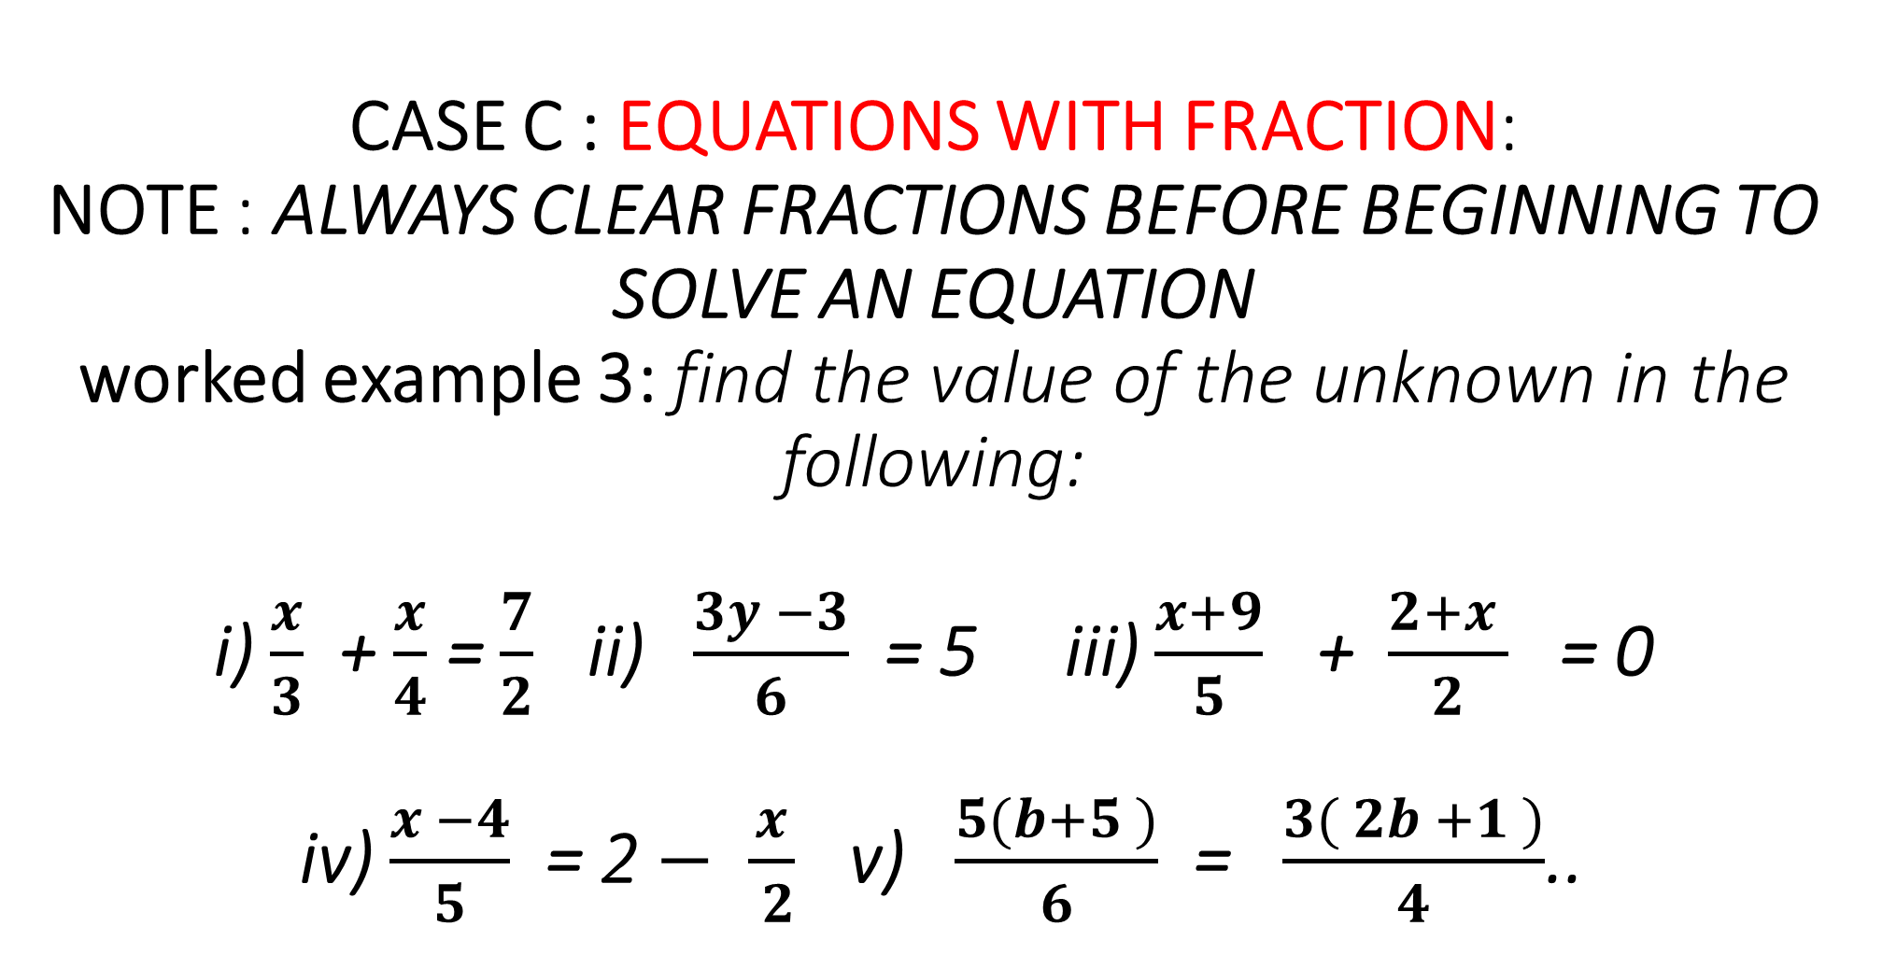
CASE C : EQUATIONS WITH FRACTION:
NOTE : ALWAYS CLEAR FRACTIONS BEFORE BEGINNING TO SOLVE AN EQUATION worked example 3: find the value of the unknown in the following: i) $\frac{x}{3}$ + $\frac{x}{4}$ = $\frac{7}{2}$ ii) $\frac{3y −3}{6}$ = 5 iii) $\frac{x+9}{5}$ + $\frac{2+x }{2}$ = 0 iv) $\frac{x −4}{5}$ = 2 $−$ $\frac{x}{ 2}$ v) $\frac{5(b+5 )}{6}$ = $\frac{3( 2b +1 )}{4}$..
TOPIC: algebraic equation

Slide 57
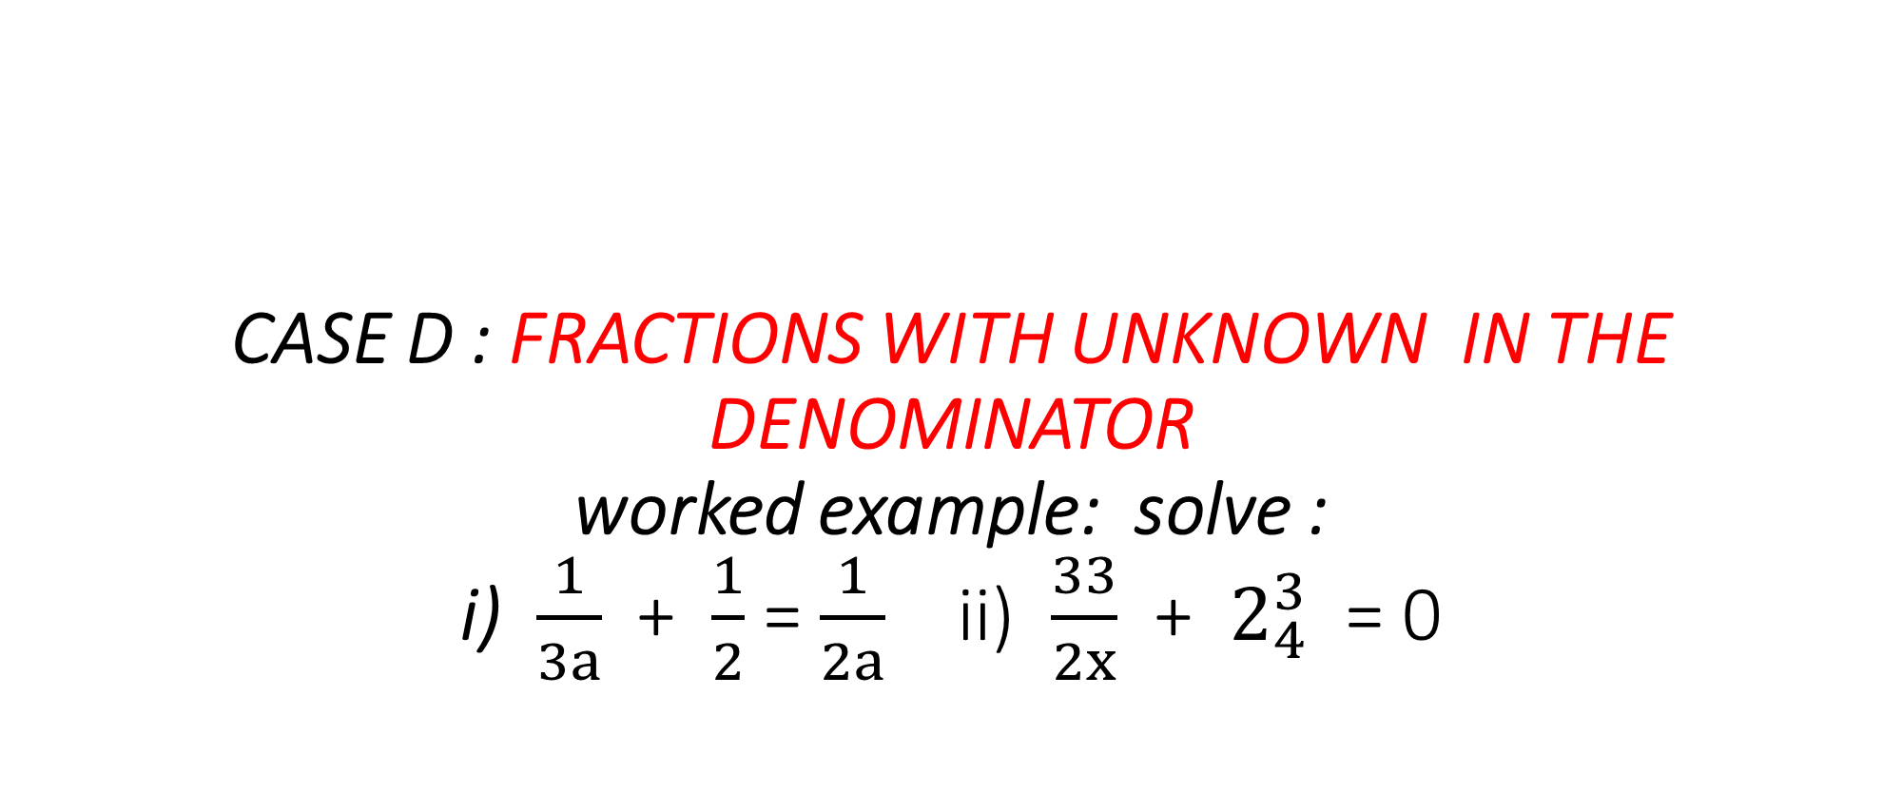
CASE D : FRACTIONS WITH UNKNOWN IN THE DENOMINATOR worked example: solve : i) $\frac{1}{3a}$ + $\frac{1}{2}$ = $\frac{1}{2a}$ ii) $\frac{33}{2x}$ + $2_{4}^{3}$ = 0
TOPIC: algebraic equation

Slide 58
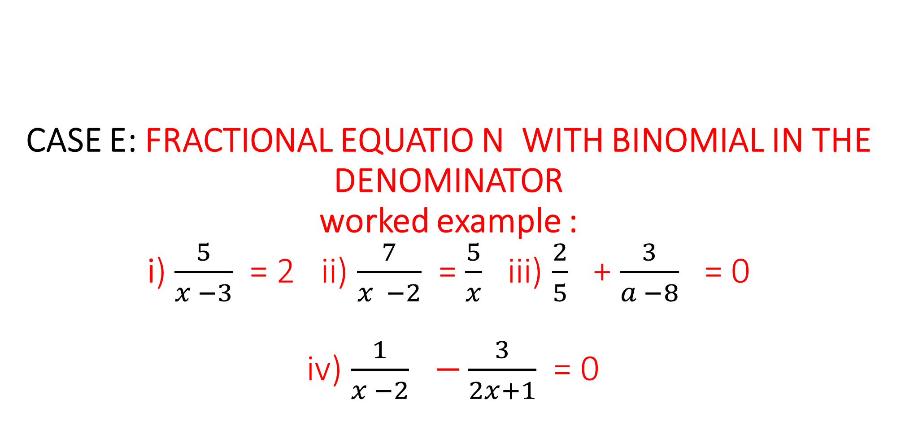
CASE E: FRACTIONAL EQUATIO N WITH BINOMIAL IN THE DENOMINATOR worked example : i) $\frac{5}{x −3}$ = 2 ii) $\frac{7}{x −2}$ = $\frac{5}{x}$ iii) $\frac{2}{5}$ + $\frac{3}{a −8}$ = 0 iv) $\frac{1}{x −2}$ $−\frac{3}{2x+1}$ = 0
TOPIC: algebraic equation

Slide 59
CASE F : WORD PROBLEMS ON EQUATIONS
WORKED EXAMPLE: a) calculate the value of x in the triangle below , given that its perimeter is 28cm. b) find the value of p in the fig. below: c) find the area of the fig. below , if the perimeter is 52cm.
TOPIC: algebraic equation
(2x - 1)cm
(3x +1)cm
(x +4)cm
(3x - 2)cm
(3p +8)cm
(2x +3)cm
(6p - 4)cm

Slide 60
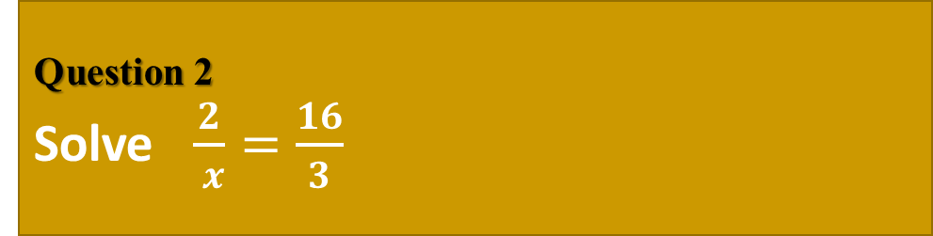


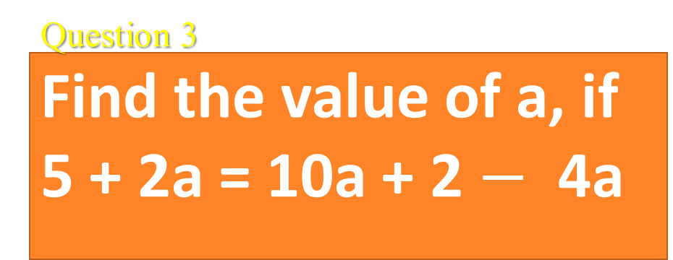
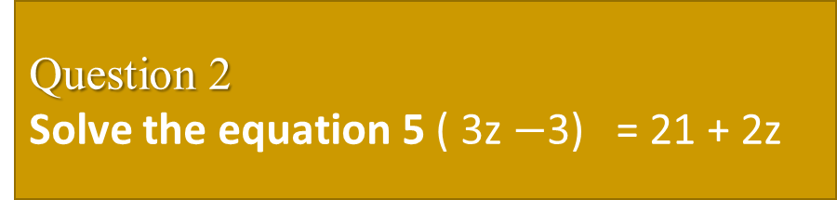
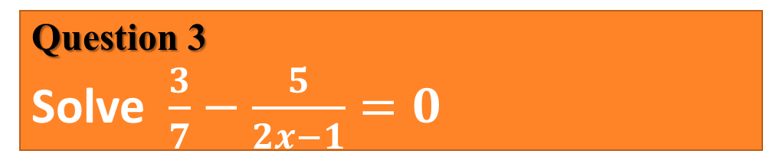
TOPIC: algebraic equation > Evaluation
Question 1
Solve for x in $\frac{7}{x} −\frac{1}{2}=\frac{5}{x}$
Question 1
Find the value of x .
(3x +1)cm
(5x $−$3)cm
Question 2
Solve the equation 5 ( 3z $−$3) = 21 + 2z
Question 2
Solve $\frac{2}{ x}=\frac{16}{3}$
Question 3
Find the value of a, if 5 + 2a = 10a + 2 $−$ 4a
Question 3
Solve $\frac{3}{7}$ $−$ $\frac{5}{2x−1}=0$
Question 4
Question 4
The masses of a mother and her daughter differ by 27kg, and are in the ratio 8: 5. find each of their masses

Slide 61
Any Questions?

Slide 62
TOPIC: word problems
Use appropriate symbols for the operations such as sum, difference, product and quotient
Create an expression or an equation from word problem an solve it
Solve word problems involving whole numbers and fractions
WORD PROBLEMS
HOME PAGE

Slide 63
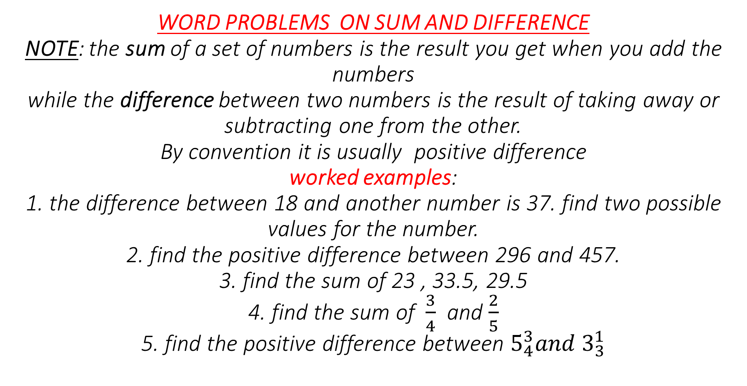
WORD PROBLEMS ON SUM AND DIFFERENCE
NOTE: the sum of a set of numbers is the result you get when you add the numbers while the difference between two numbers is the result of taking away or subtracting one from the other.
By convention it is usually positive difference worked examples:
1. the difference between 18 and another number is 37. find two possible values for the number.
2. find the positive difference between 296 and 457.
3. find the sum of 23 , 33.5, 29.5
4. find the sum of $\frac{3}{4}$ and $\frac{2}{5}$
5. find the positive difference between $5_{4}^{3}{and 3}_{3}^{1}$
TOPIC: word problems

Slide 64
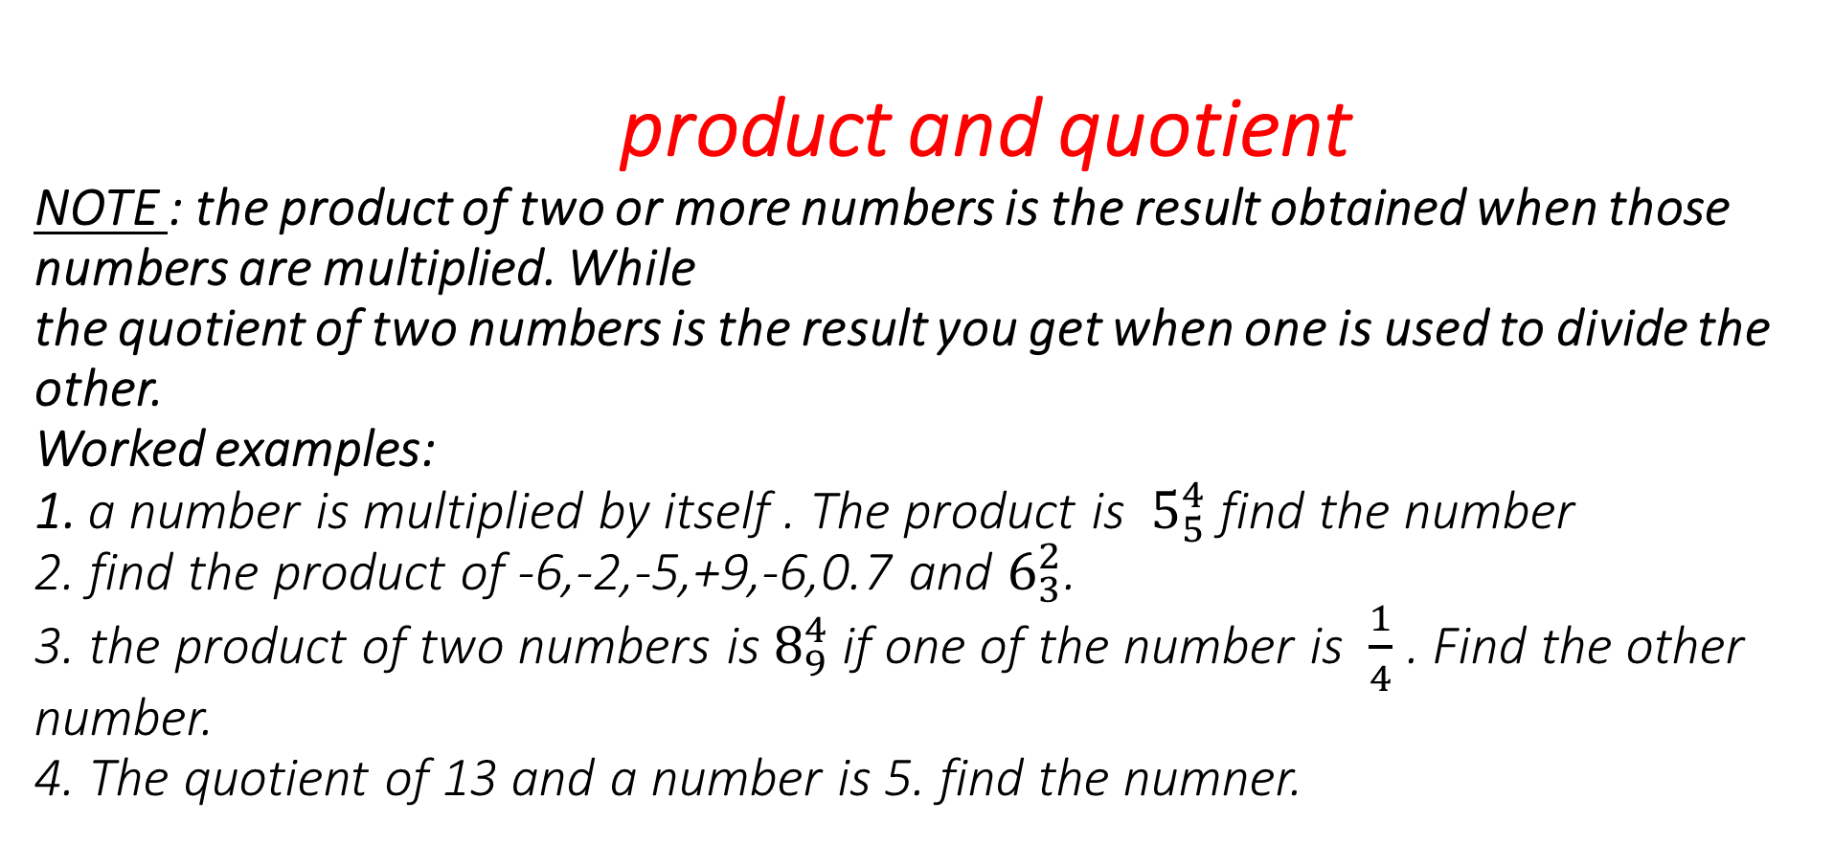
product and quotient
NOTE : the product of two or more numbers is the result obtained when those numbers are multiplied. While the quotient of two numbers is the result you get when one is used to divide the other.
Worked examples:
1. a number is multiplied by itself . The product is $5_{5}^{4}$ find the number
2. find the product of -6,-2,-5,+9,-6,0.7 and $6_{3}^{2}$.
3. the product of two numbers is $8_{9}^{4}$ if one of the number is $\frac{1}{4}$ . Find the other number.
4. The quotient of 13 and a number is 5. find the numner.
TOPIC: word problems

Slide 65
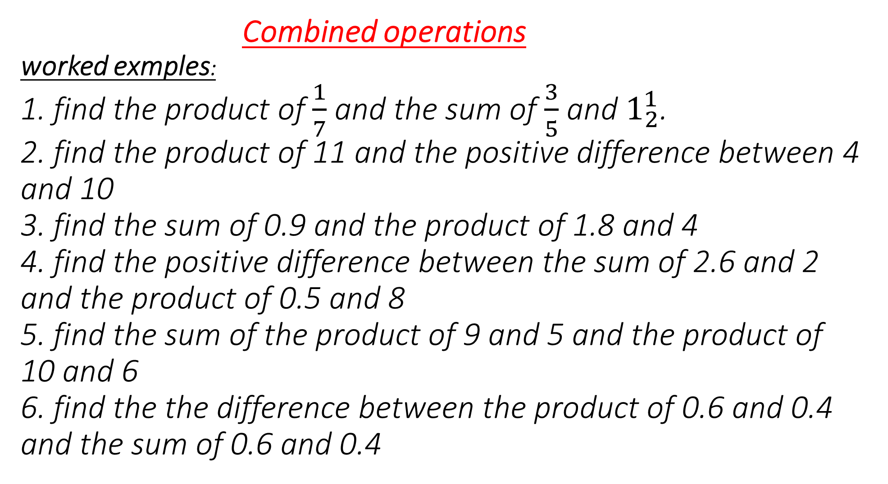
Combined operations worked exmples:
1. find the product of $\frac{1}{7}$ and the sum of $\frac{3}{5}$ and $1_{2}^{1}$.
2. find the product of 11 and the positive difference between 4 and 10
3. find the sum of 0.9 and the product of 1.8 and 4
4. find the positive difference between the sum of 2.6 and 2 and the product of 0.5 and 8
5. find the sum of the product of 9 and 5 and the product of 10 and 6
6. find the the difference between the product of 0.6 and 0.4 and the sum of 0.6 and 0.4
TOPIC: word problems

Slide 66
EXPRESSION WITH FRACTION worked examples:
1. divide 50 by the sum of 3 and 7
2. find one –ninth of the positive difference between 55 and sum of 12 and 7
3. what is the one- quarter of the positive difference between 29 and 11.
TOPIC: word problems

Slide 67
WORD PROBLEMS ON EQUATIONS
1. the product of a certain number and 5 is equal to twice the number subtracted from 20. what is the number.
2. the sum of 35 and a certain number is divided by 4 . If the result is equal to double the number . Find the number
3. 20 is divided by the sum of 2 and n . If the result is 4, find n
4. when I divided 48 by the sum of 5 and a certain number , the result is 3. what is the number?
5. a father is 24 years older than his son , if the ratio of their ages is 5: 2 . What is the age of the son?
6. a brother is 3 years older than his sister. Five years ago, the ratio of their ages was 4 : 3 . Find their present ages.
7.Three times a certain number plus 6 is equal to twice the number plus 15. find the number
TOPIC: word problems

Slide 68
8. I think of a number , add 7, multiply by 3, subtract 3, divide by 4 and then multiply by 12 , the result is 72. what is the number?
9. in timi’s class , there are three times as many students who wear glasses as those who do not.if there are 28 tudents in the class . How many students do not wear glasses?
10. two times a certain number is subtracted from 25 and the result is the same as when is added to 6 times the number. Find the number
11. timi has 5 times as many books as her friend, Bola. If Timi gave out 16 books to her friend, they would have the same number of books. How many books does each have?
TOPIC: word problems

Slide 69
TOPIC: word problems > Evaluation
Question 1
A chord of a circle of 24cm long is 5cm from the centre of the circle. Find its radius.
Question 1
Which of the following are Pythagorean triple? 1) 12, 35, 37 . 2) 4, 8, 9. 3) 4, 5, 6.
Question 2
Find the vertical height of a cone whose diameter is 10cm and slant height is 13cm.
Question 2
A man walked 5km northward and 8km westward. Find his distance from the starting point
Question 3
Find x and y in this fig.
6cm
y
Question 3
A rectangular piece is 120m by 60m. Find its diagonal.
3cm
x
8cm
Question 4
The diagonals of a rhombus are 6cm and 8cm respectively. Find the perimeter of the rhombus.
Question 4
Complete the Pythagorean triples below: 1) 8, __, 17 . 2) __, 8 ,10. 3) 7, 24, __ .

Slide 70
Any Questions?

Slide 71
TOPIC: factorization
Remove brackets from algebraic expression
Find the common and highest common factors of an algebraic expression.
Factorize algebraic expression by taking common factors.
Use re- group to factorize expression with four terms.
Use factorization to simplify calculations..
FACTORIZATION 1
HOME PAGE
Binomial expressions are algebraic expression with two terms.
Factorize simply means to write a number or expression as a product of its factors.
Grouping : means arranging terms in a more convenient way

Slide 72
REMOVING BRACKETS FROM ALGEBRAIC EXPRESSION
WORKED EXAMPLES : remove the brackets from the following: i) 3 ( 2x – y) ii.) ( 3a + 8b ) 5a (iii). - 2n ( 7y – 4z)
TOPIC: factorization

Slide 73
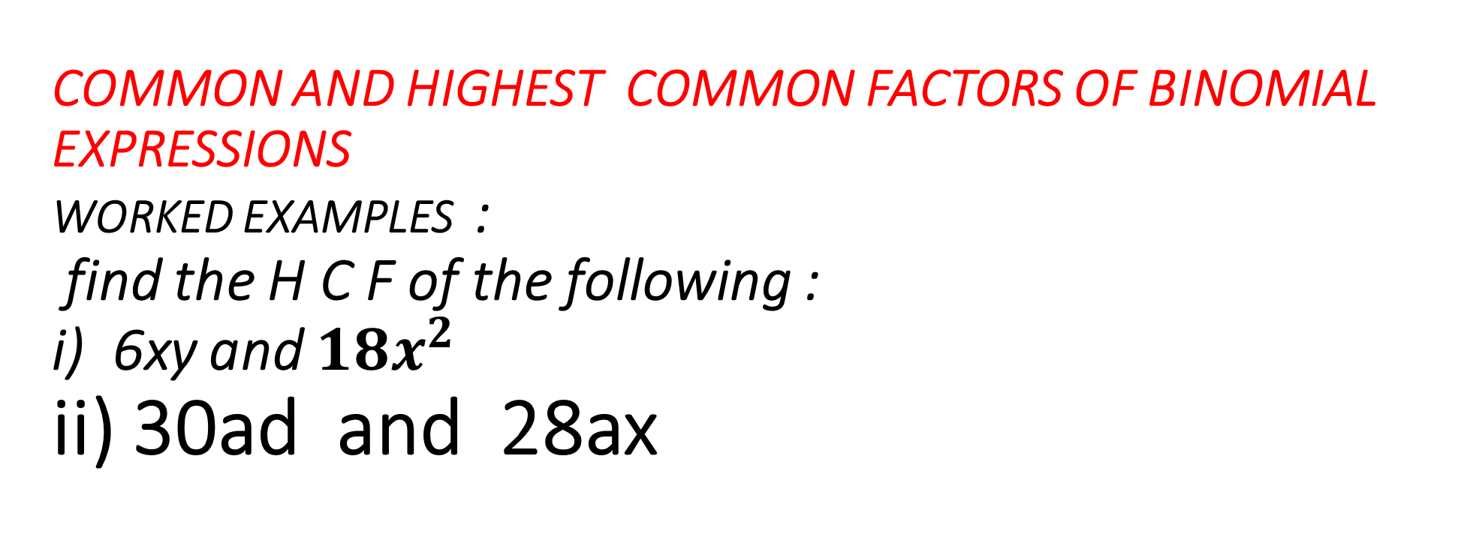
COMMON AND HIGHEST COMMON FACTORS OF BINOMIAL EXPRESSIONS
WORKED EXAMPLES : find the H C F of the following : i) 6xy and ${18x}^{2}$ ii) 30ad and 28ax
TOPIC: factorization

Slide 74
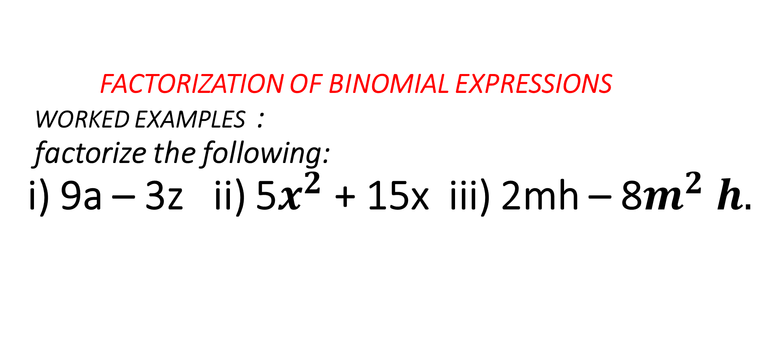
FACTORIZATION OF BINOMIAL EXPRESSIONS
WORKED EXAMPLES : factorize the following: i) 9a – 3z ii) 5$x^{2}$ + 15x iii) 2mh – 8$m^{2} h.$
TOPIC: factorization

Slide 75
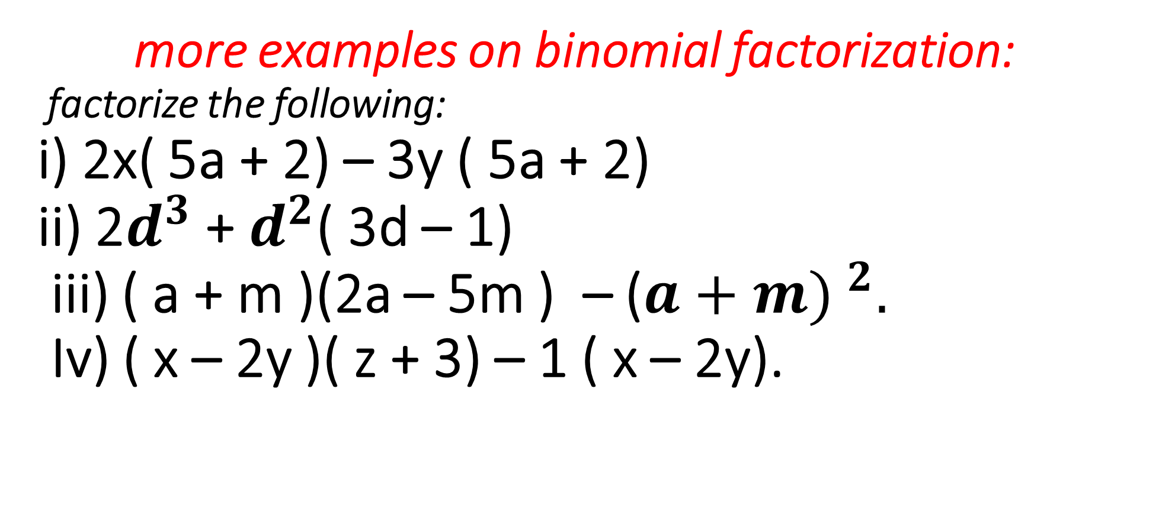
more examples on binomial factorization: factorize the following: i) 2x( 5a + 2) – 3y ( 5a + 2) ii) 2$d^{3}$ + $d^{2}$( 3d – 1) iii) ( a + m )(2a – 5m ) – (${a+m) }^{2}.$
Iv) ( x – 2y )( z + 3) – 1 ( x – 2y).
TOPIC: factorization

Slide 76
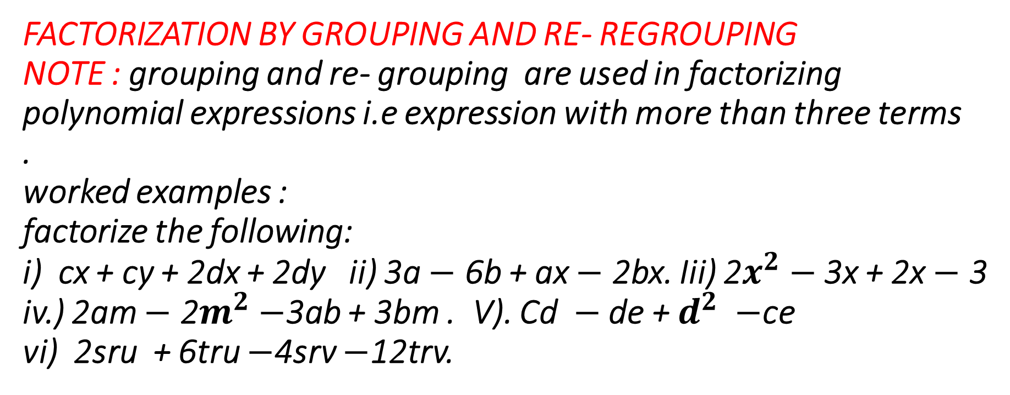
FACTORIZATION BY GROUPING AND RE- REGROUPING
NOTE : grouping and re- grouping are used in factorizing polynomial expressions i.e expression with more than three terms
. worked examples : factorize the following: i) cx + cy + 2dx + 2dy ii) 3a $−$ 6b + ax $−$ 2bx. Iii) 2$x^{2}−$ 3x + 2x $−$ 3 iv.) 2am $−$ 2$m^{2}−$3ab + 3bm . V). Cd $−$ de + $d^{2} −$ce vi) 2sru + 6tru $−$4srv $−$12trv.
TOPIC: factorization

Slide 77

FACTORIZATION BY GROUPING AND RE- REGROUPING
NOTE : grouping and re- grouping are used in factorizing polynomial expressions i.e expression with more than three terms
. worked examples : factorize the following: i) cx + cy + 2dx + 2dy ii) 3a $−$ 6b + ax $−$ 2bx. Iii) 2$x^{2}−$ 3x + 2x $−$ 3 iv.) 2am $−$ 2$m^{2}−$3ab + 3bm . V). Cd $−$ de + $d^{2} −$ce vi) 2sru + 6tru $−$4srv $−$12trv.
TOPIC: factorization

Slide 78
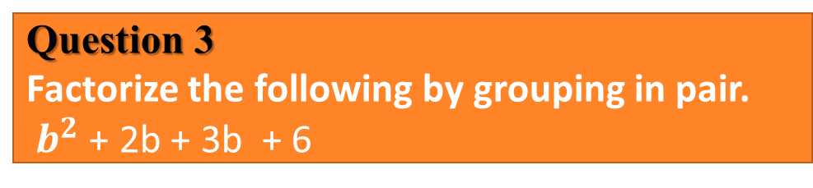
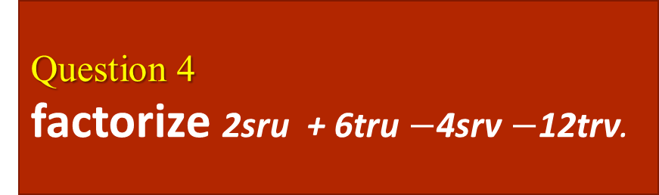
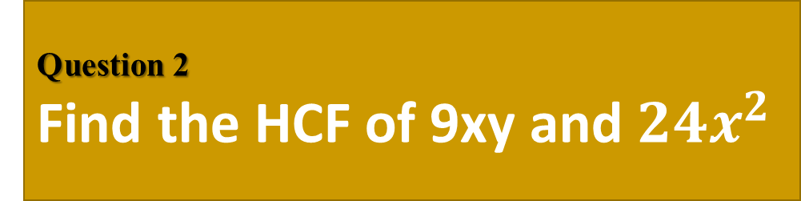
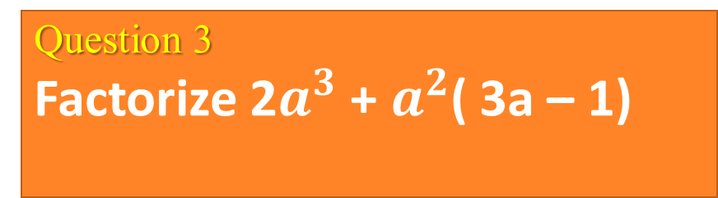
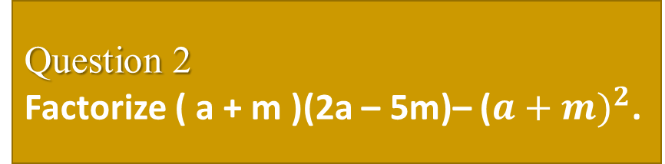
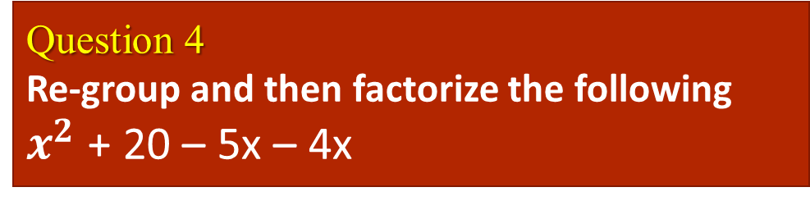
TOPIC: factorization > Evaluation
Question 1
Remove the bracket from ( 7 – 2n ) 3m
Question 1
Factorize xy – 3zy - 3xk + 9zk
Question 2
Factorize ( a + m )(2a – 5m)– (${a+m)}^{2}$.
Question 2
Find the HCF of 9xy and ${24x}^{2}$
Question 3
Factorize 2$a^{3}$ + $a^{2}$( 3a – 1)
Question 3
Factorize the following by grouping in pair.
$b^{2}$ + 2b + 3b + 6
Question 4
factorize 2sru + 6tru $−$4srv $−$12trv.
Question 4
Re-group and then factorize the following
$x^{2}$ + 20 – 5x – 4x

Slide 79
Any Questions?

Slide 80
TOPIC: factorization
students should be able to
Use factorization to simplify calculations
FACTORIZATION 2
HOME PAGE

Slide 81
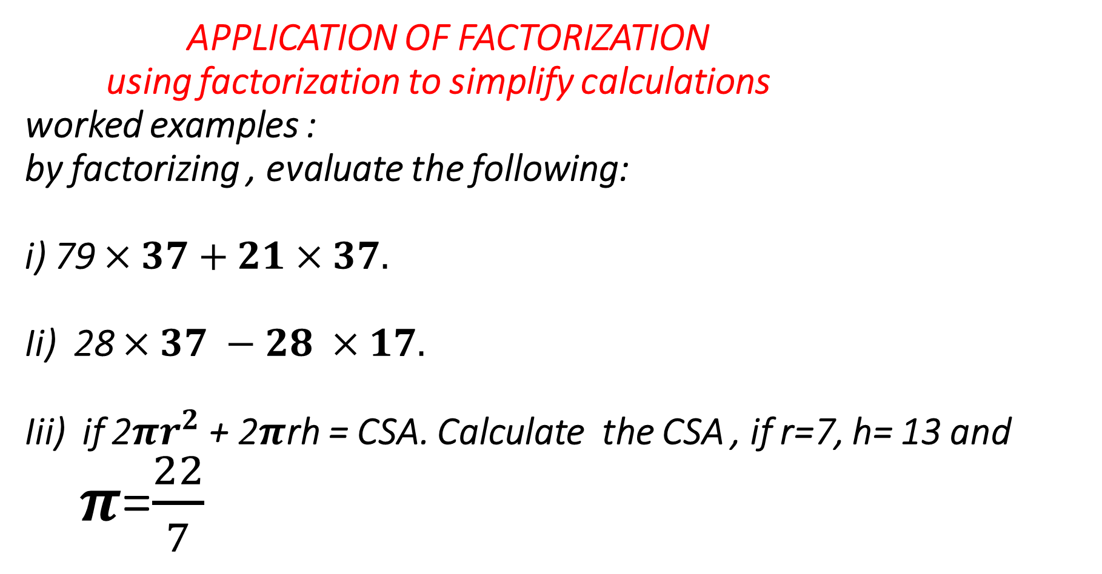
APPLICATION OF FACTORIZATION using factorization to simplify calculations worked examples : by factorizing , evaluate the following: i) 79 $×37+21×37.$
Ii) 28 $×37 −28 ×17.$
Iii) if 2${πr}^{2}$ + 2$π$rh = CSA. Calculate the CSA , if r=7, h= 13 and $π$=$\frac{22}{7}$
TOPIC: geometrical construction

Slide 82
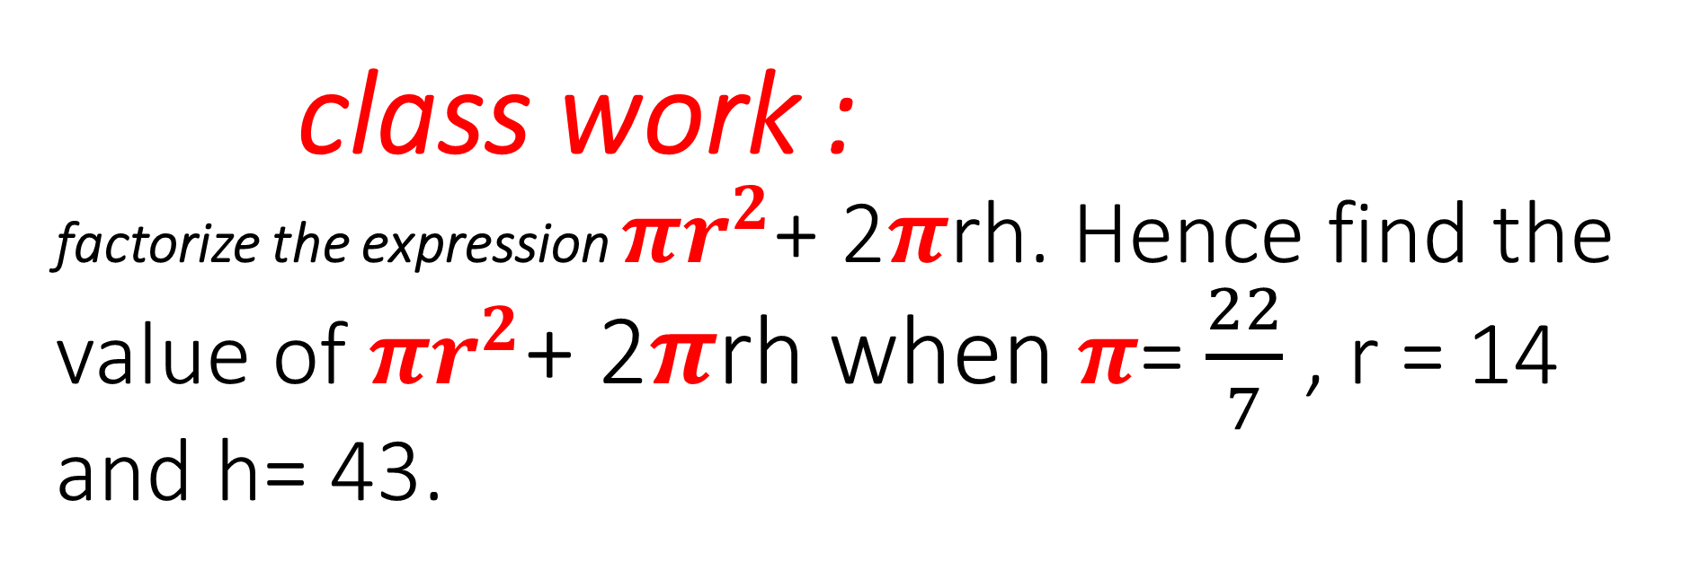
class work : factorize the expression $πr^{2}$+ 2$π$rh. Hence find the value of $πr^{2}$+ 2$π$rh when $π$= $\frac{22}{7}$ , r = 14 and h= 43.
TOPIC: geometrical construction

Slide 83
TOPIC: geometrical construction
GEOMETRICAL CONSTRUCTIONS
Bisect a straight line segment
Bisect any angles
Copy any given angle
Bisect angle 90 and 45
Construct angle 60 and 30
..
HOME PAGE
Bisection : to cut equally into half
Line segment : the part of a line between two given points.
Perpendicular bisector : a line which divide a line at 90 degree.

Slide 84
BISECTION OF LINE SEGMENT
To bisect a line segment simply means dividing the line into 2 equal parts.
EXAMPLES:
Bisect line segment with the following dimensions:
80mm ii) 110mm
TOPIC: geometrical construction

Slide 85
BISECTION OF ANGLES
To bisect an angle simply means dividing the line into 2 equal parts.
EXAMPLES: with the aid of a pair of compasses measure out and bisect the following angles: a) 75⁰ b) 90⁰
TOPIC: geometrical construction

Slide 86
copying a given angle
EXAMPLES: with the aid of a pair of compasses , copy the angles bellow: a) b)
TOPIC: geometrical construction
A
X
B
C
Y
Z

Slide 87
CONSTRUCTION OF BASIC ANGLES
( COMPASS ANGLES )
EXAMPLES: with the aid of a pair of compasses , construct the following angles: a) 90⁰ b) 60⁰ c) 45⁰ d) 30⁰ e) 75⁰
TOPIC: geometrical construction

Slide 88
TOPIC: > geometrical construction > Evaluation
Question 1
Draw and Bisect a line segment of length 120mm
Question 1
Question 2
Question 2
Using protractor draw and bisect an angle of 60 degree
Question 3
Question 3
Using a pair of compasses, construct angle 90
Question 4
Question 4
With pair of compasses construct 30

Slide 89
Any Questions?

